Slide 1
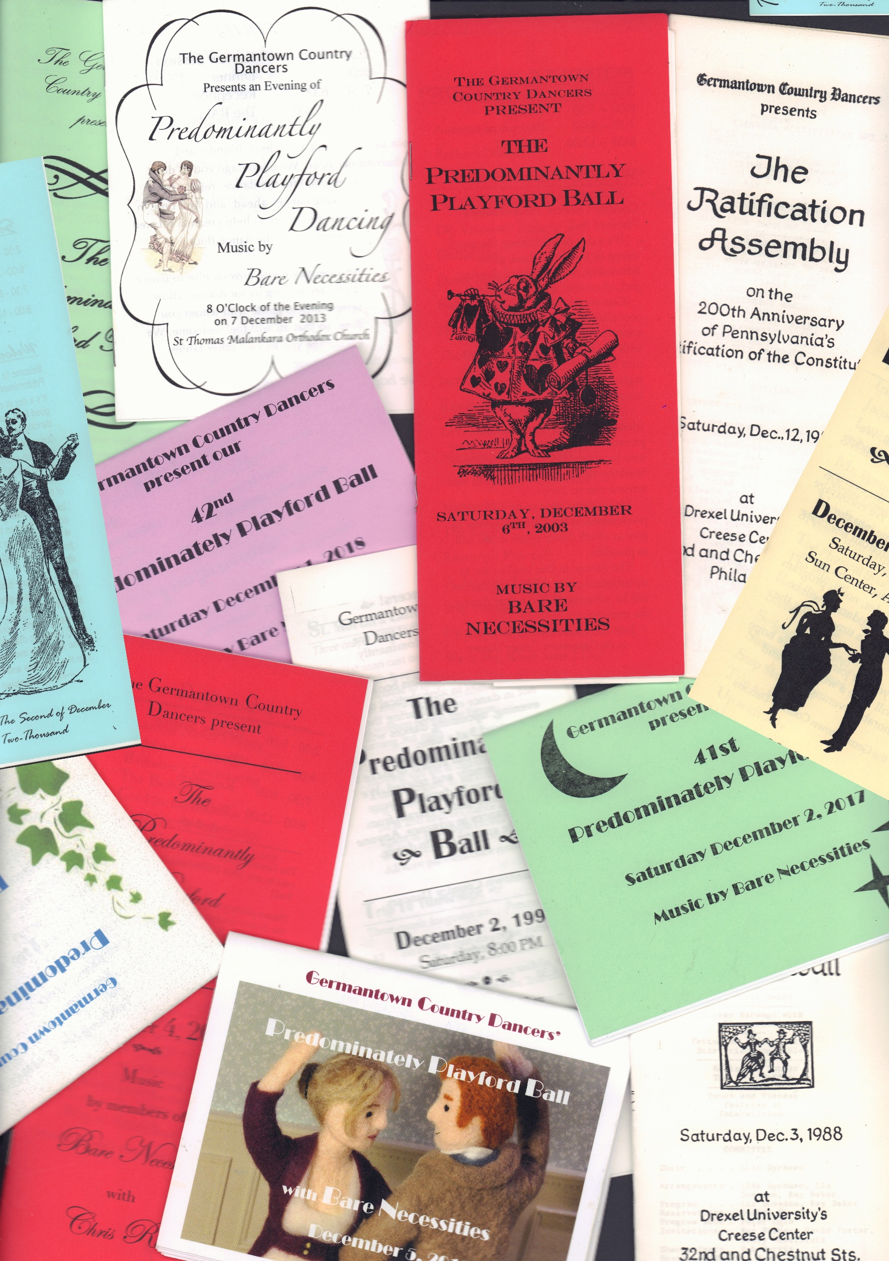
Germantown Country Dancers’
Predominantly
Playford
Ball Booklets
1977 - 2019

Slide 2
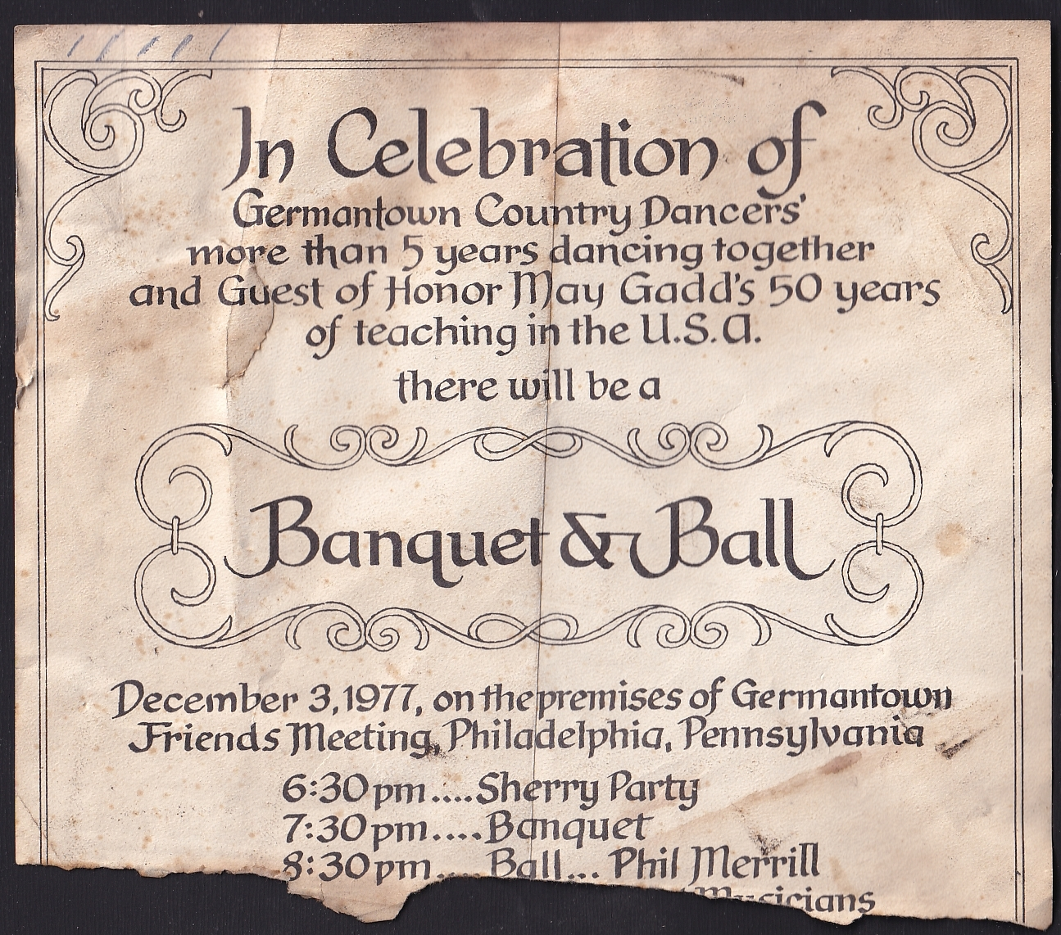
1977

Slide 3
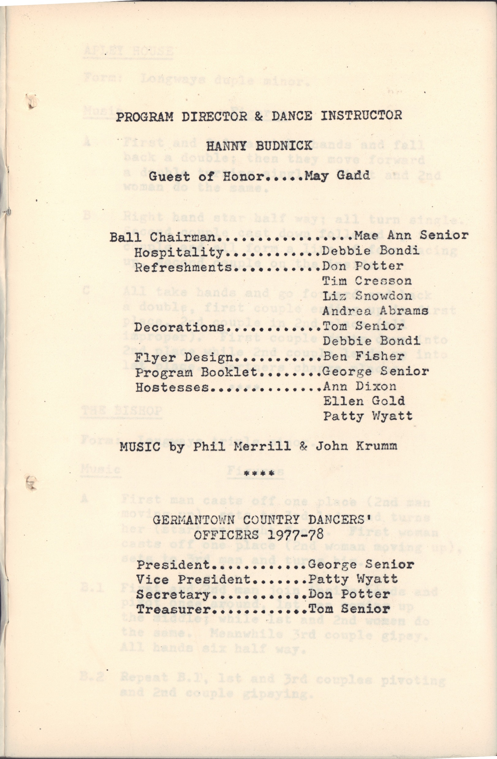
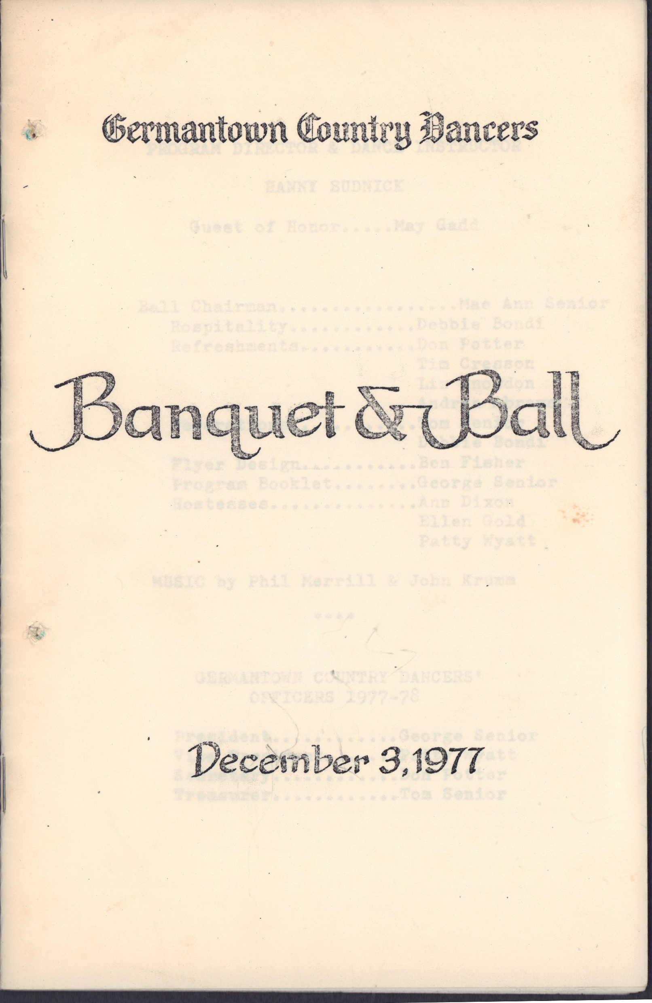
1977
The Program
Apley House
The Bishop
The Black Nag
Childgrove
The Duke of Kent’s Waltz
Draper’s Maggot
Fandango
The Geud Man of Ballangigh
Hunsdon House
Jenny Pluck Pears
Mage on a Cree
Newcastle
Hey Boys Up Go We
Hit and Miss
Hole in the Wall
Nonesuch
The Old Mole
Orleans Baffled
Parson’s Farewell
Picking Up Sticks
Prince William
Sellenger’s Round
The Twenty-Ninth of May
Up with Aily

Slide 4
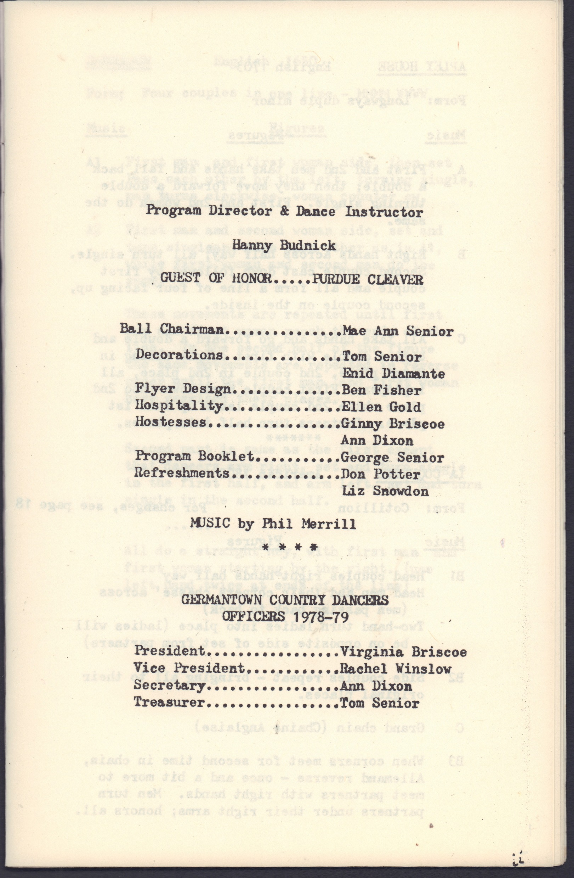
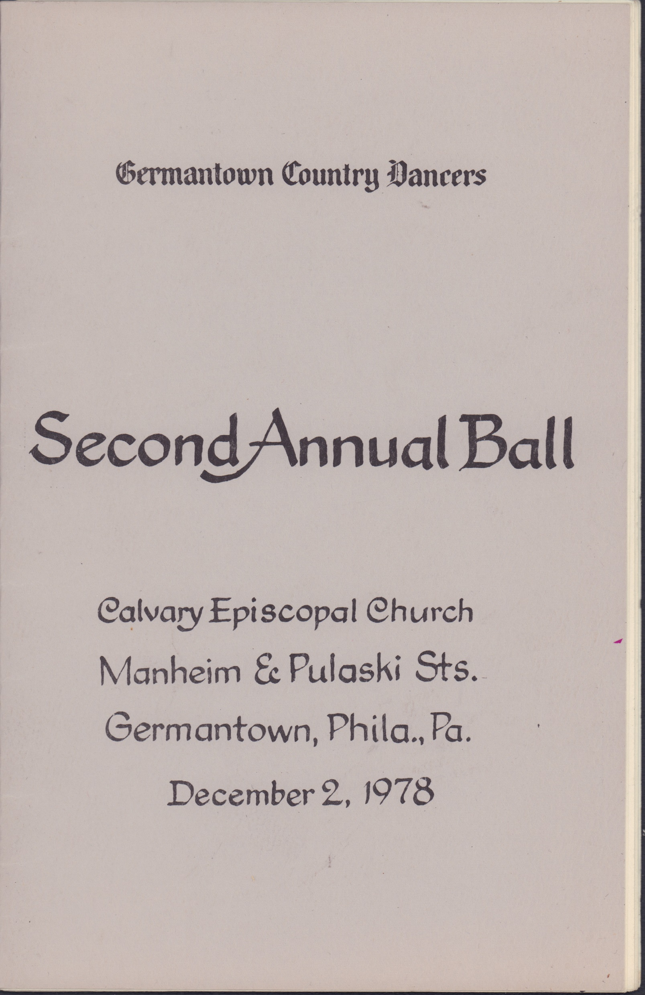
1978

Slide 5
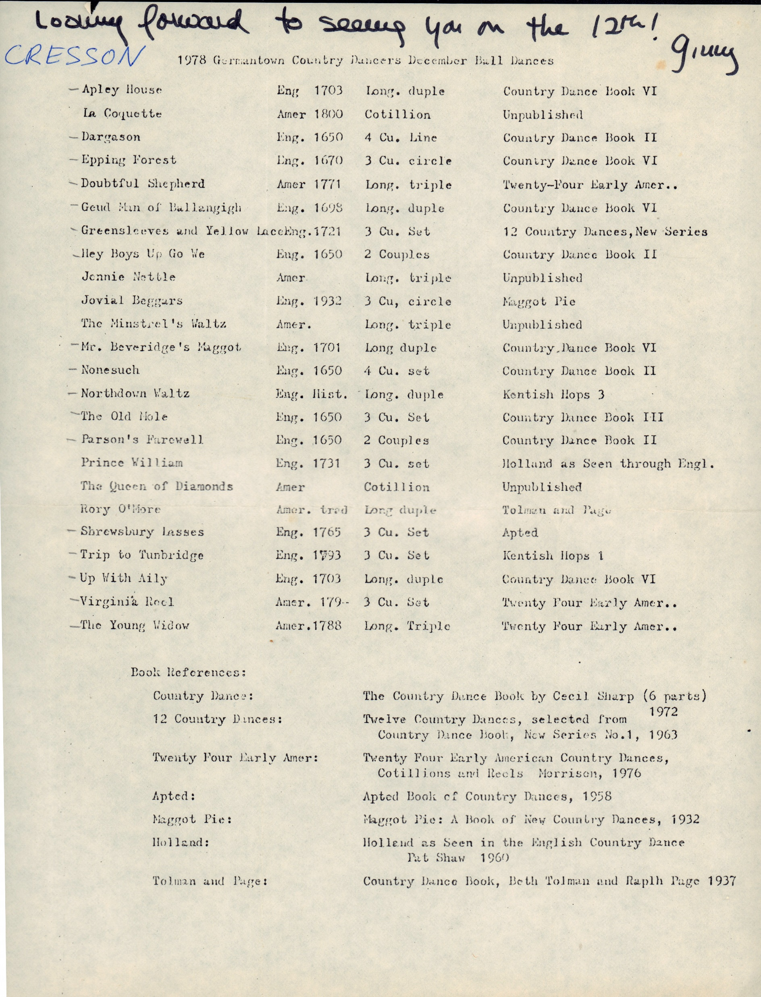
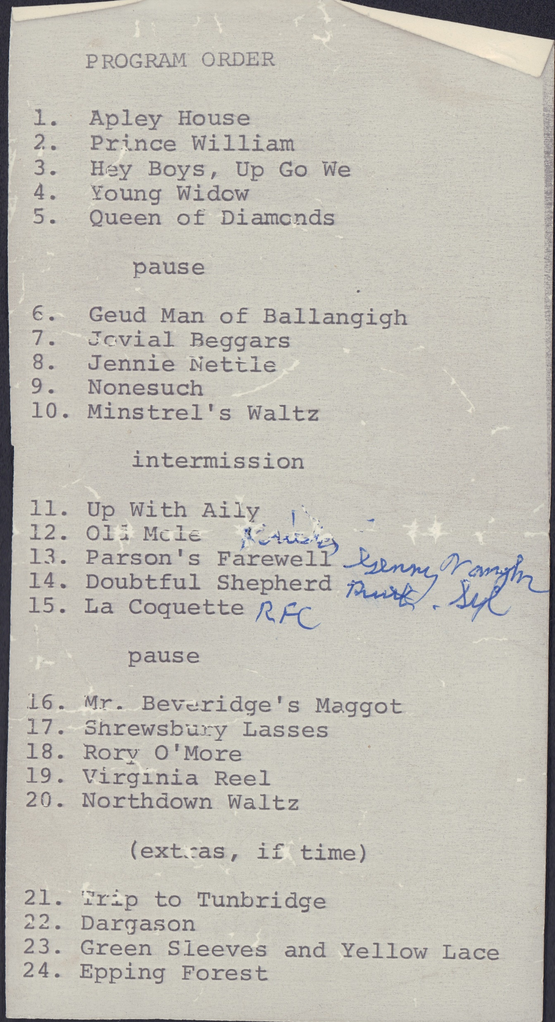
1978

Slide 6
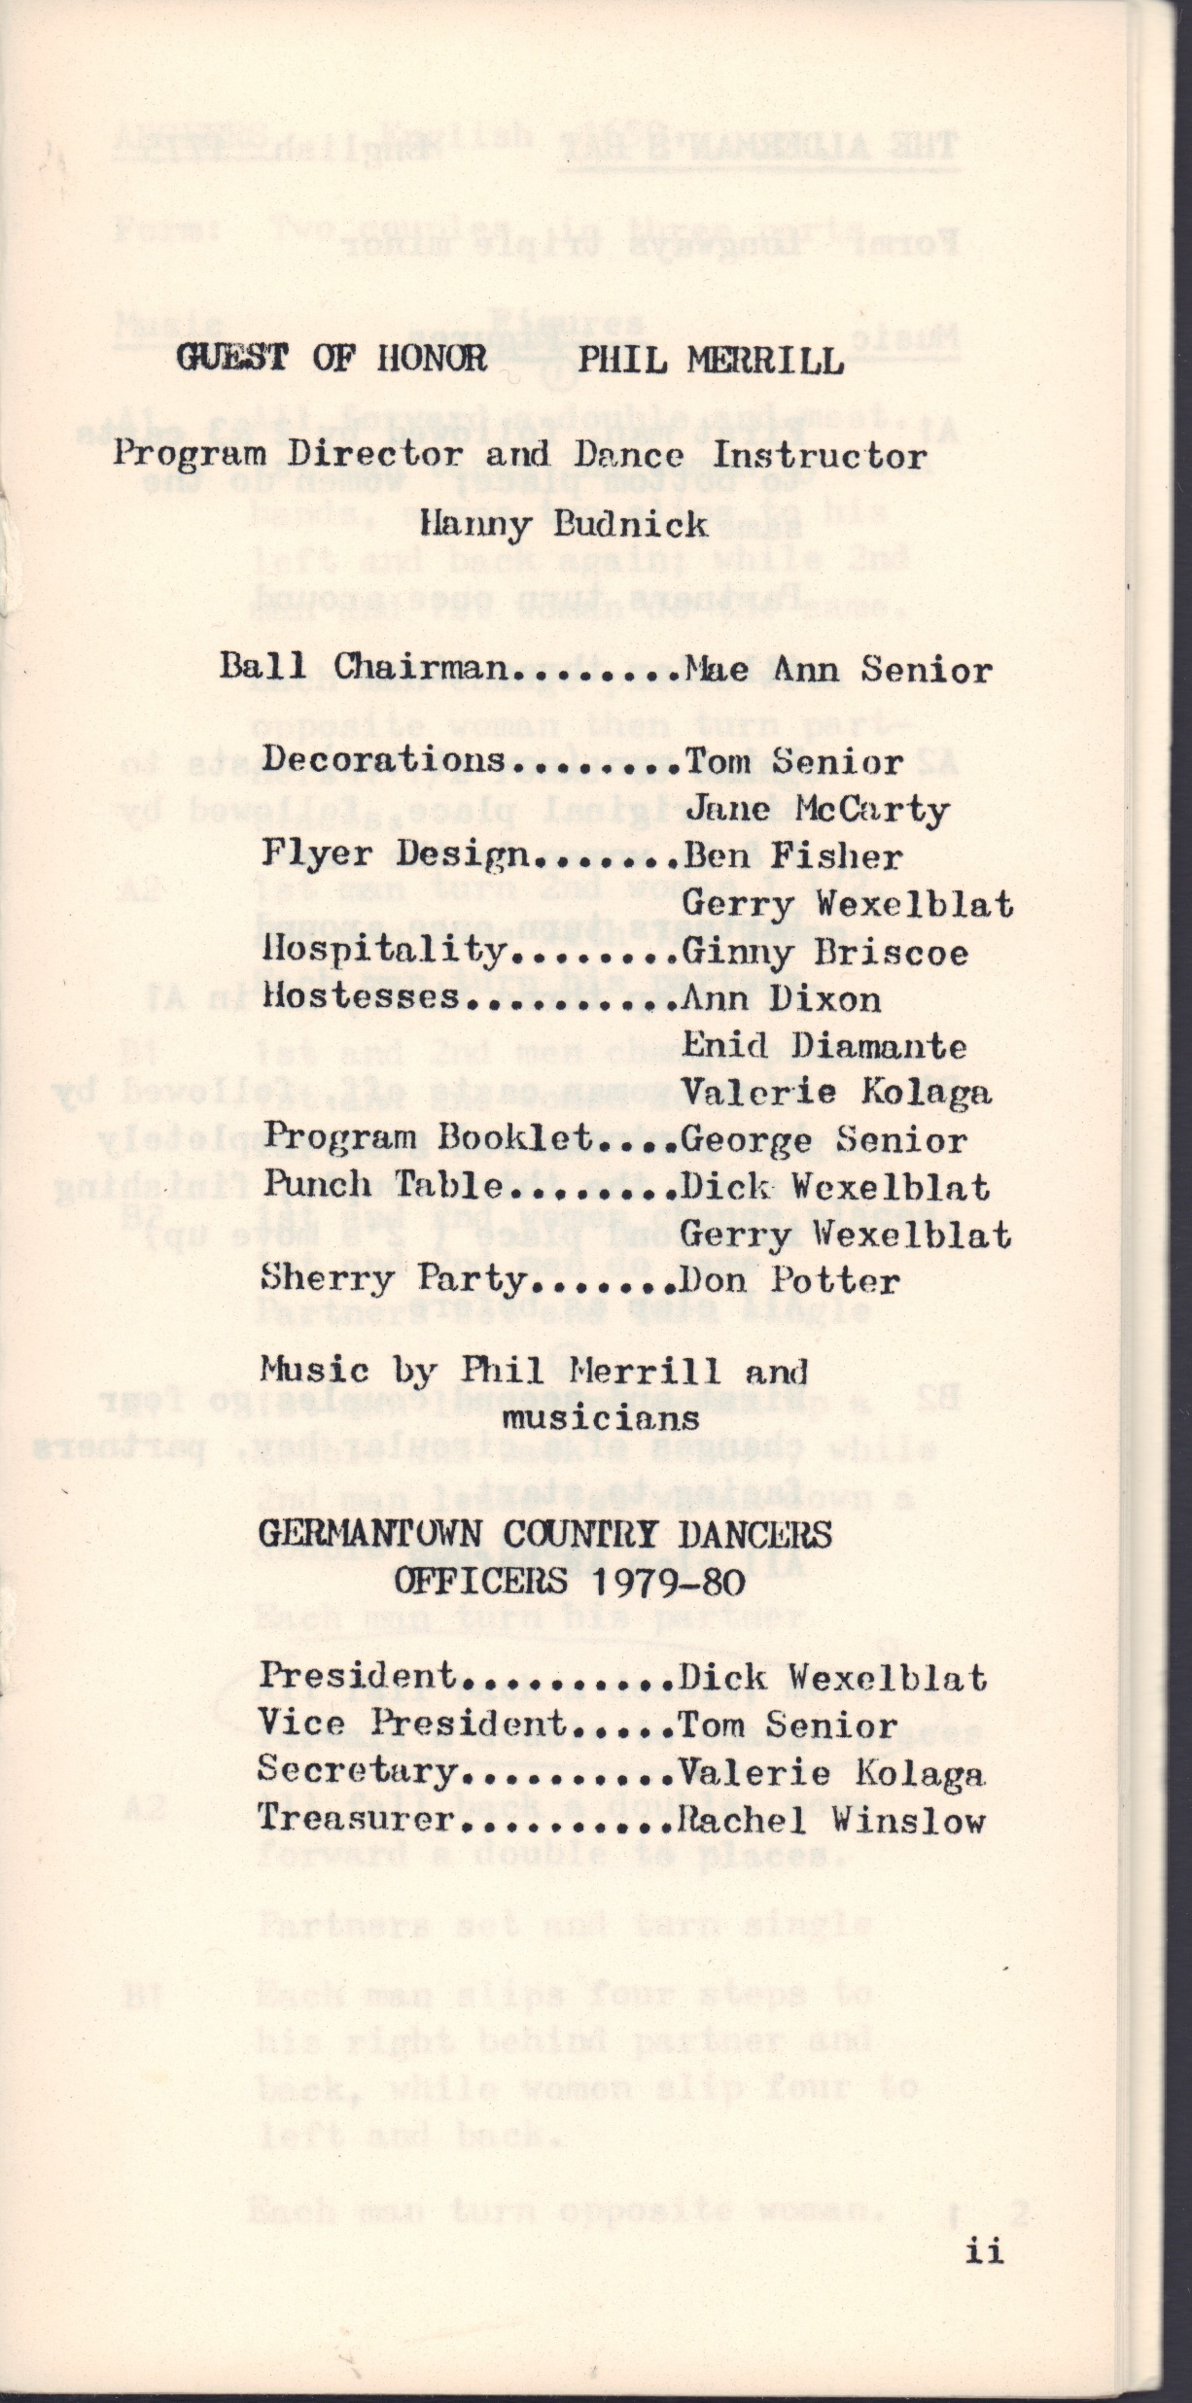
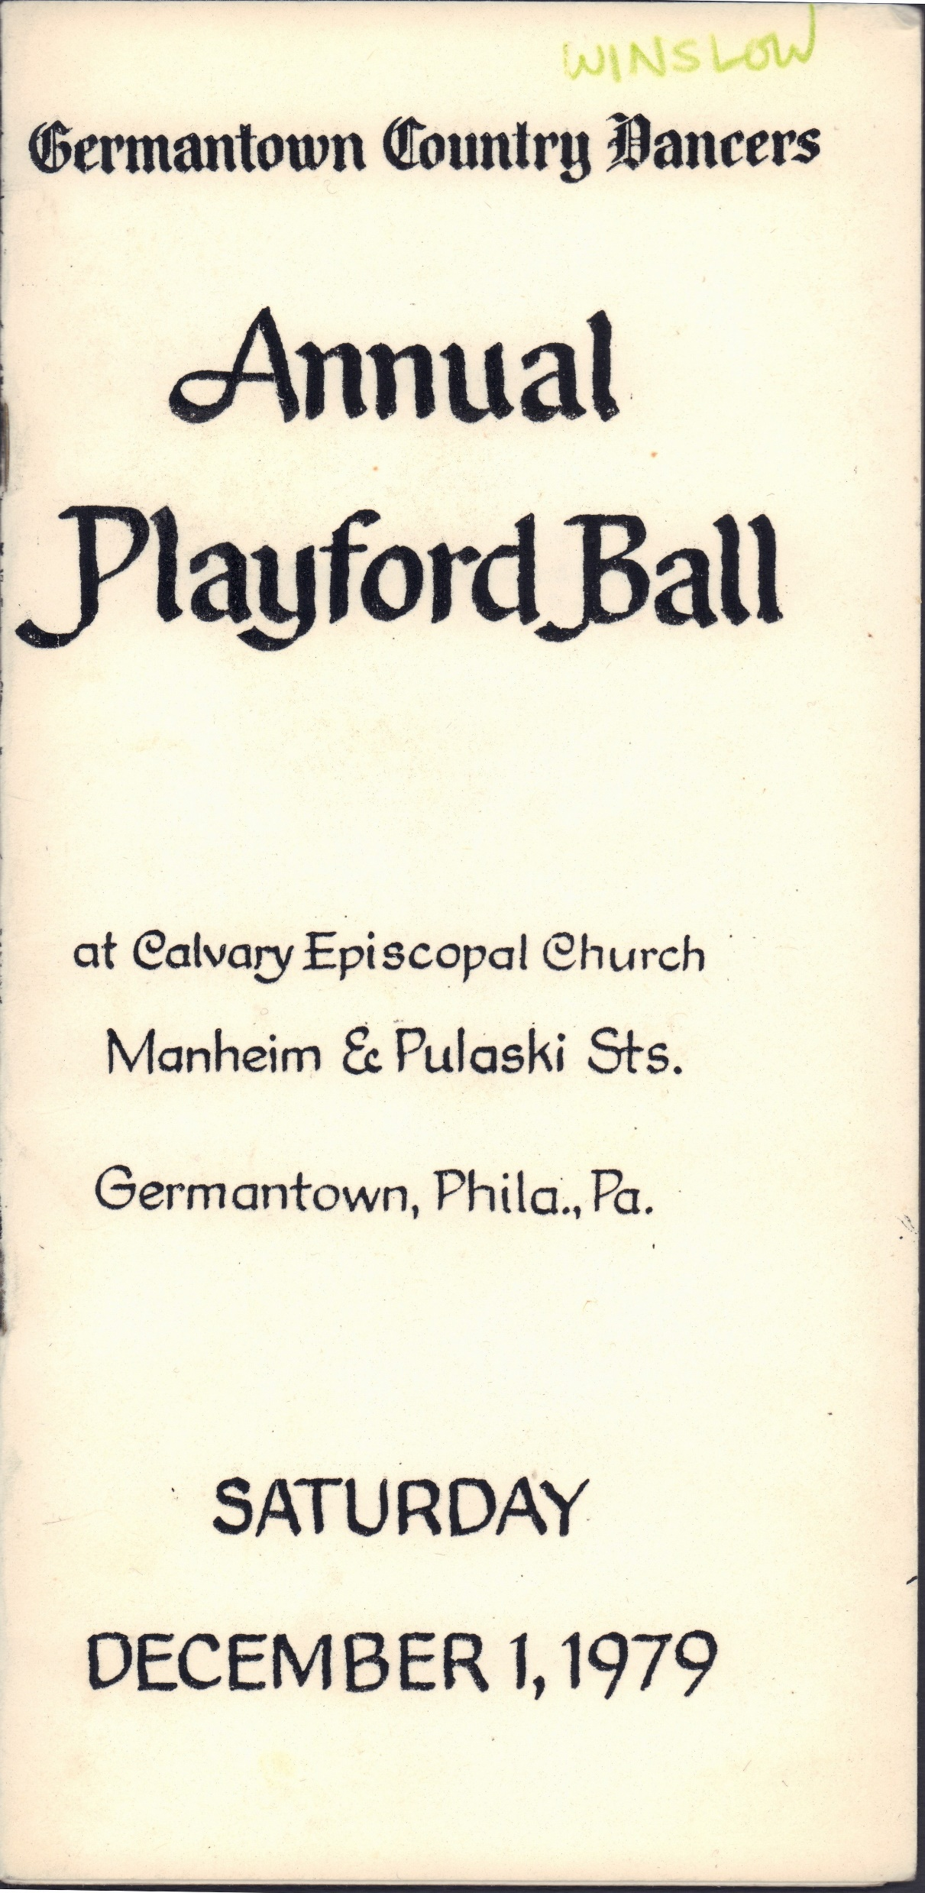
The Program
The Alderman’s Hat
Argeers
Christchurch Bells
Epping Forest
The Female Sayler
Green Sleeves and Yellow Lace
Green Willow
The Hole in the Wall
Lull Me Beyond Thee
Mr. Beveridge’s Maggot
My Lady Cullen
Newcastle
Oranges and Lemons
Orleans Baffled
The Phoenix
Picking Up Sticks
The Queen’s Jig
Scotch Cap
Sellenger’s Round
Step Stately
Up With Aily
1979

Slide 7
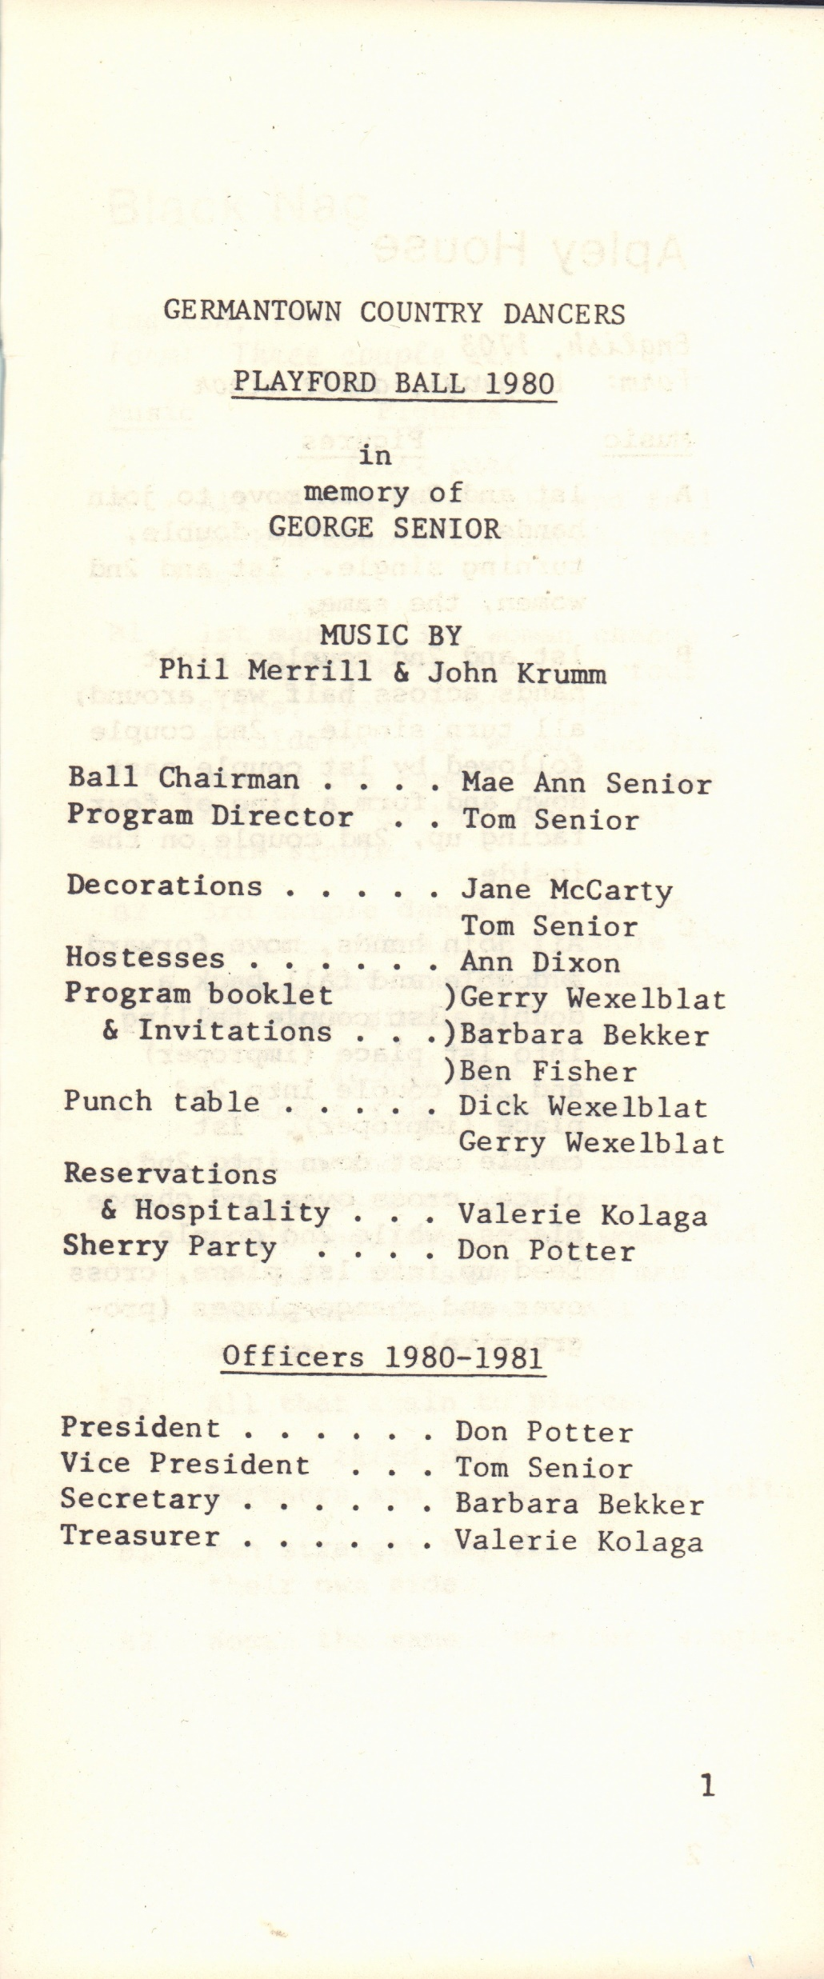
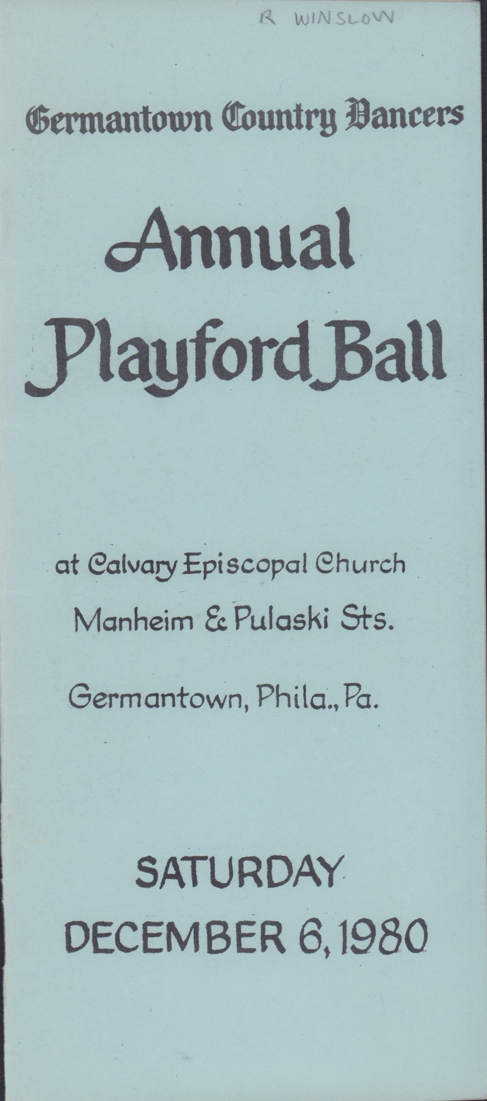
The Program
Apley House
The Black Nag
The Boatman
Childgrove
Chestnut
Dick’s Maggot
Drapers Gardens
The Dressed Ship
The Fandango
Dublin Bay
Hanbleton’s Round O
Heartsease
Hit and Miss
Jack’s Health
Juno and Palla
Morpeth Rant
The Northdown Waltz
New Castle
The Old Mole
Orleans Baffled
Parson’s Farewell
The Queen’s Jig
Rufty Tufty
Scotch Cap
Sellenger’s Round
The Spaniard
Up with Aily
Upon a Summer’s Day
1980

Slide 8
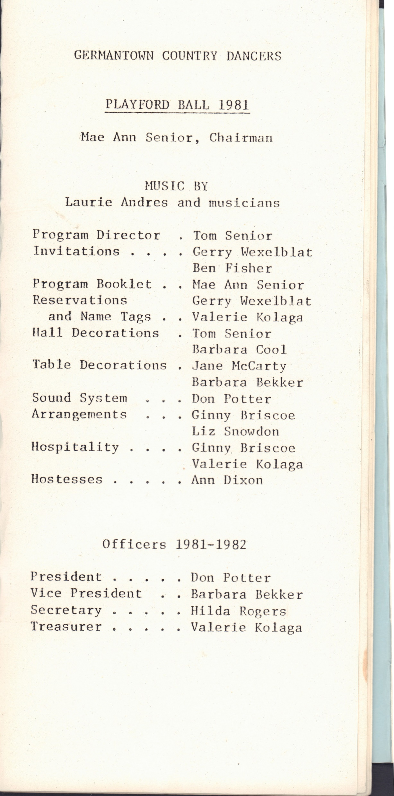
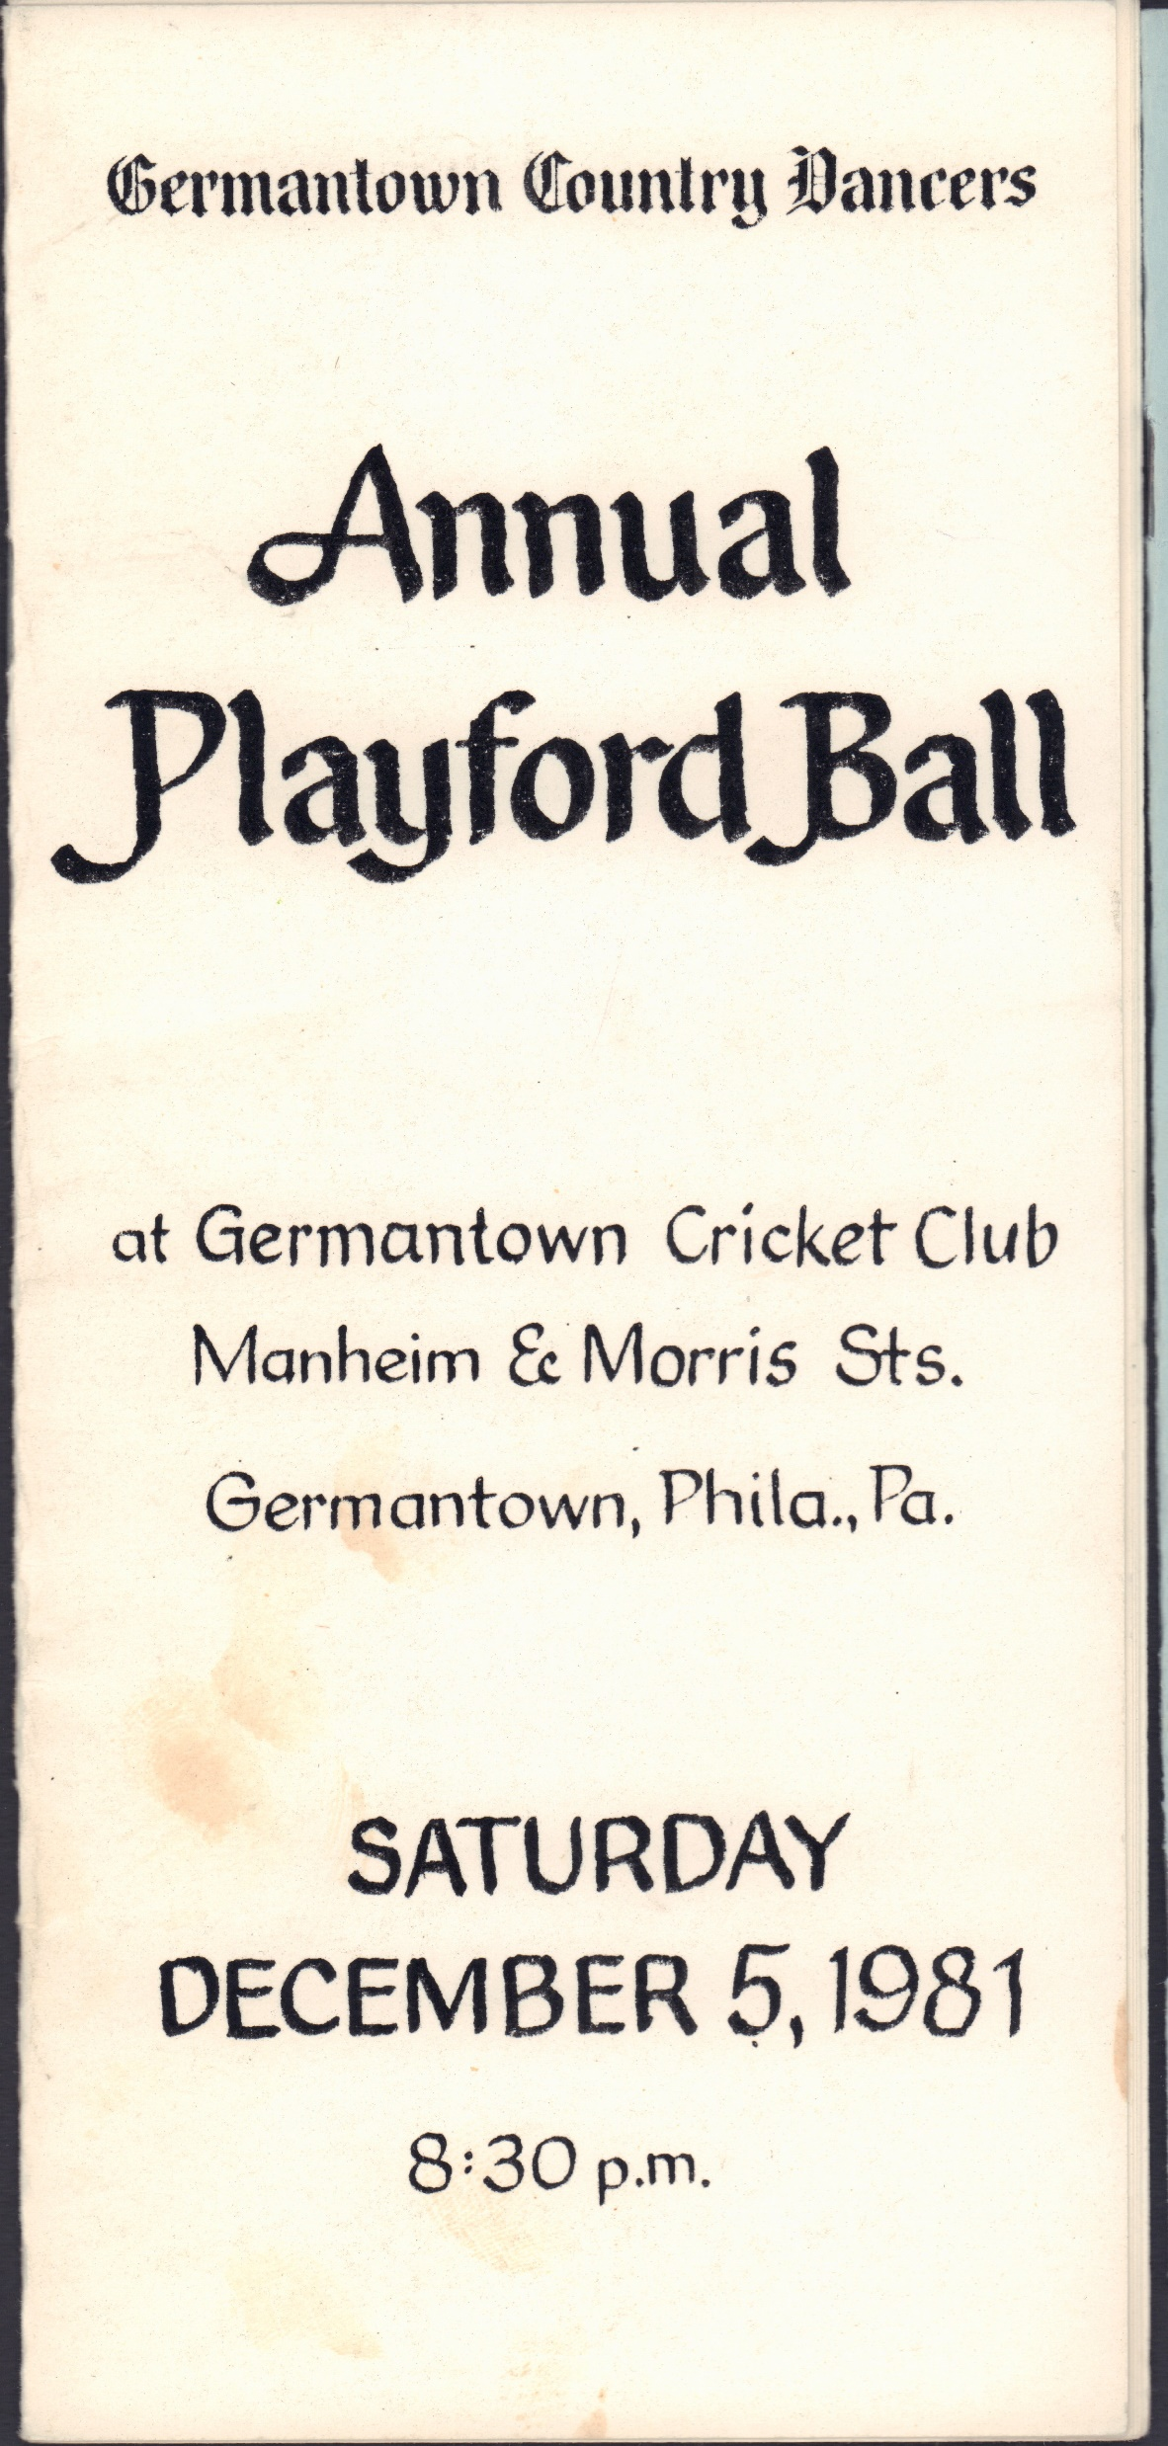
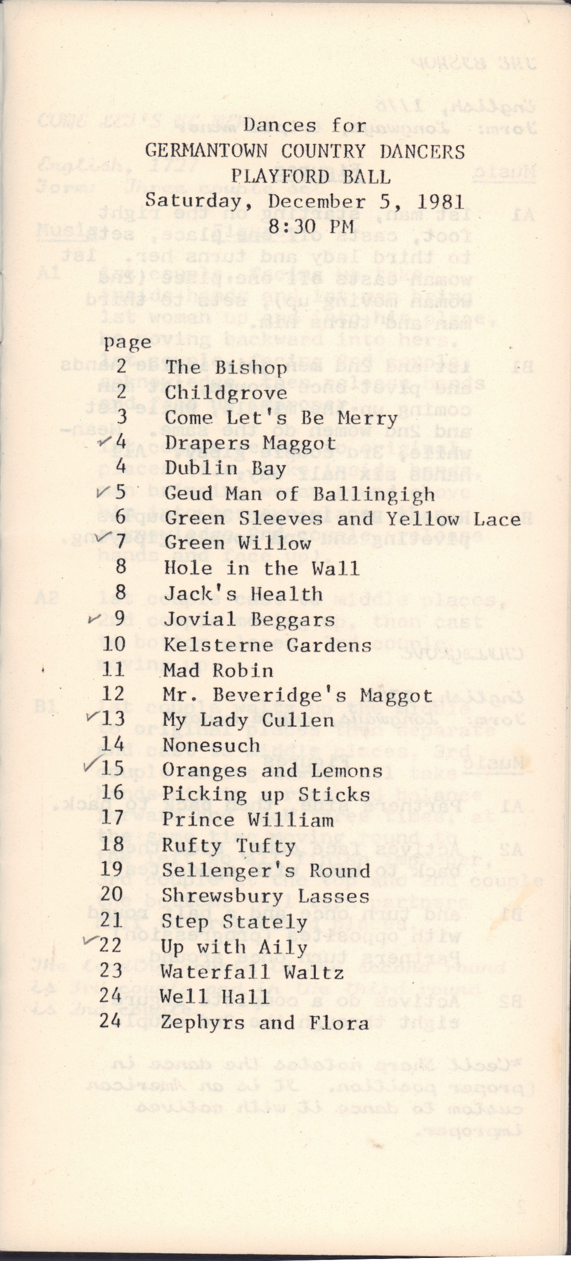
1981

Slide 9
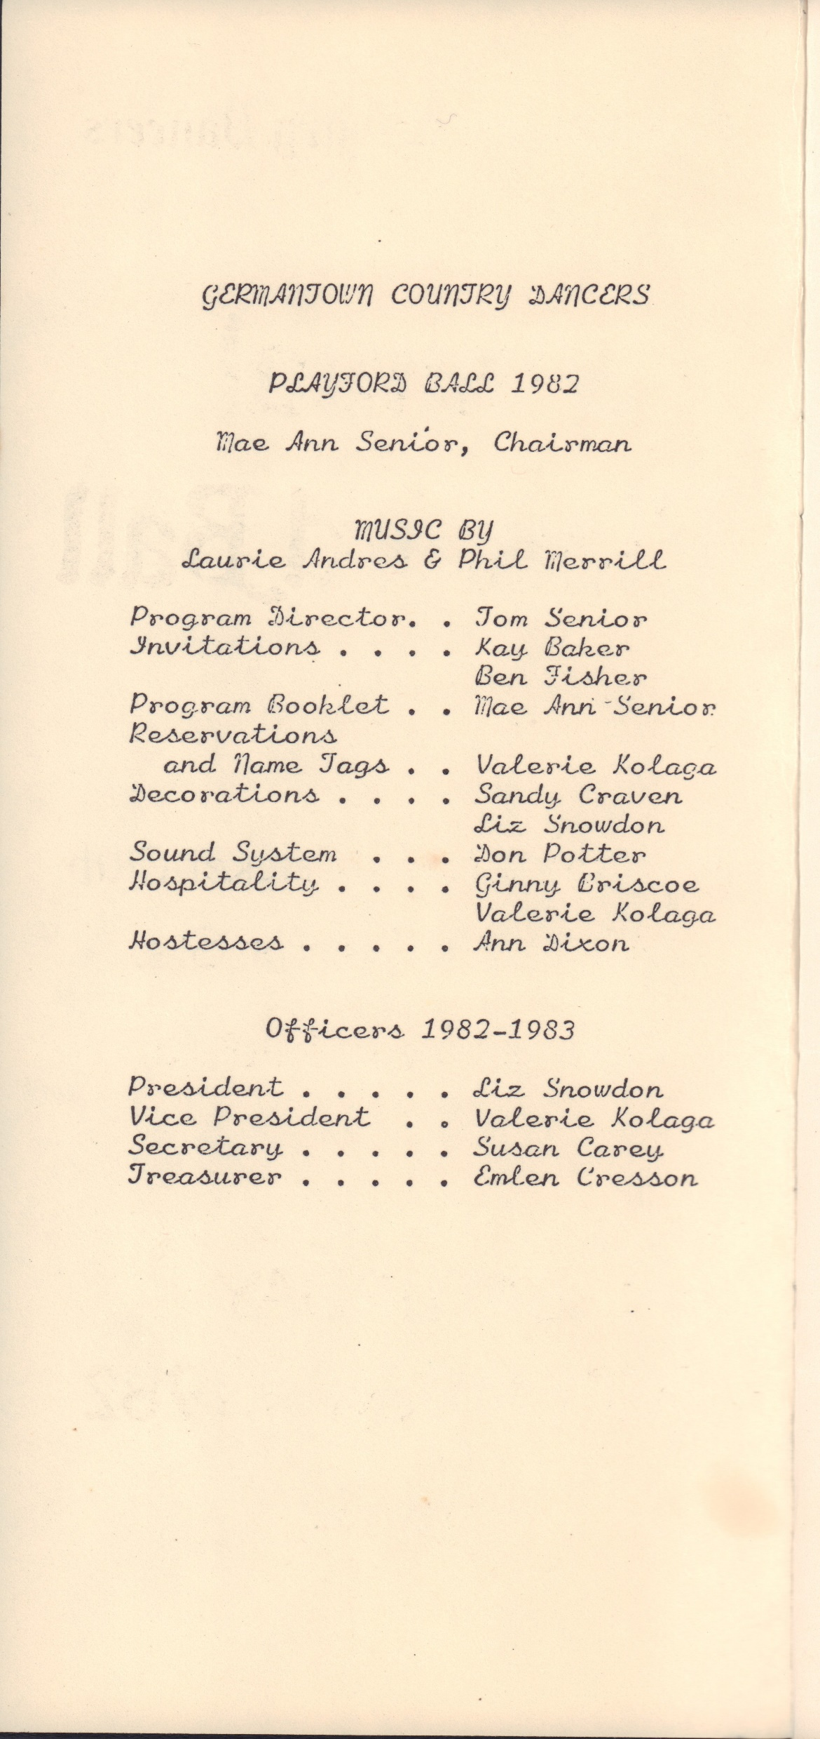
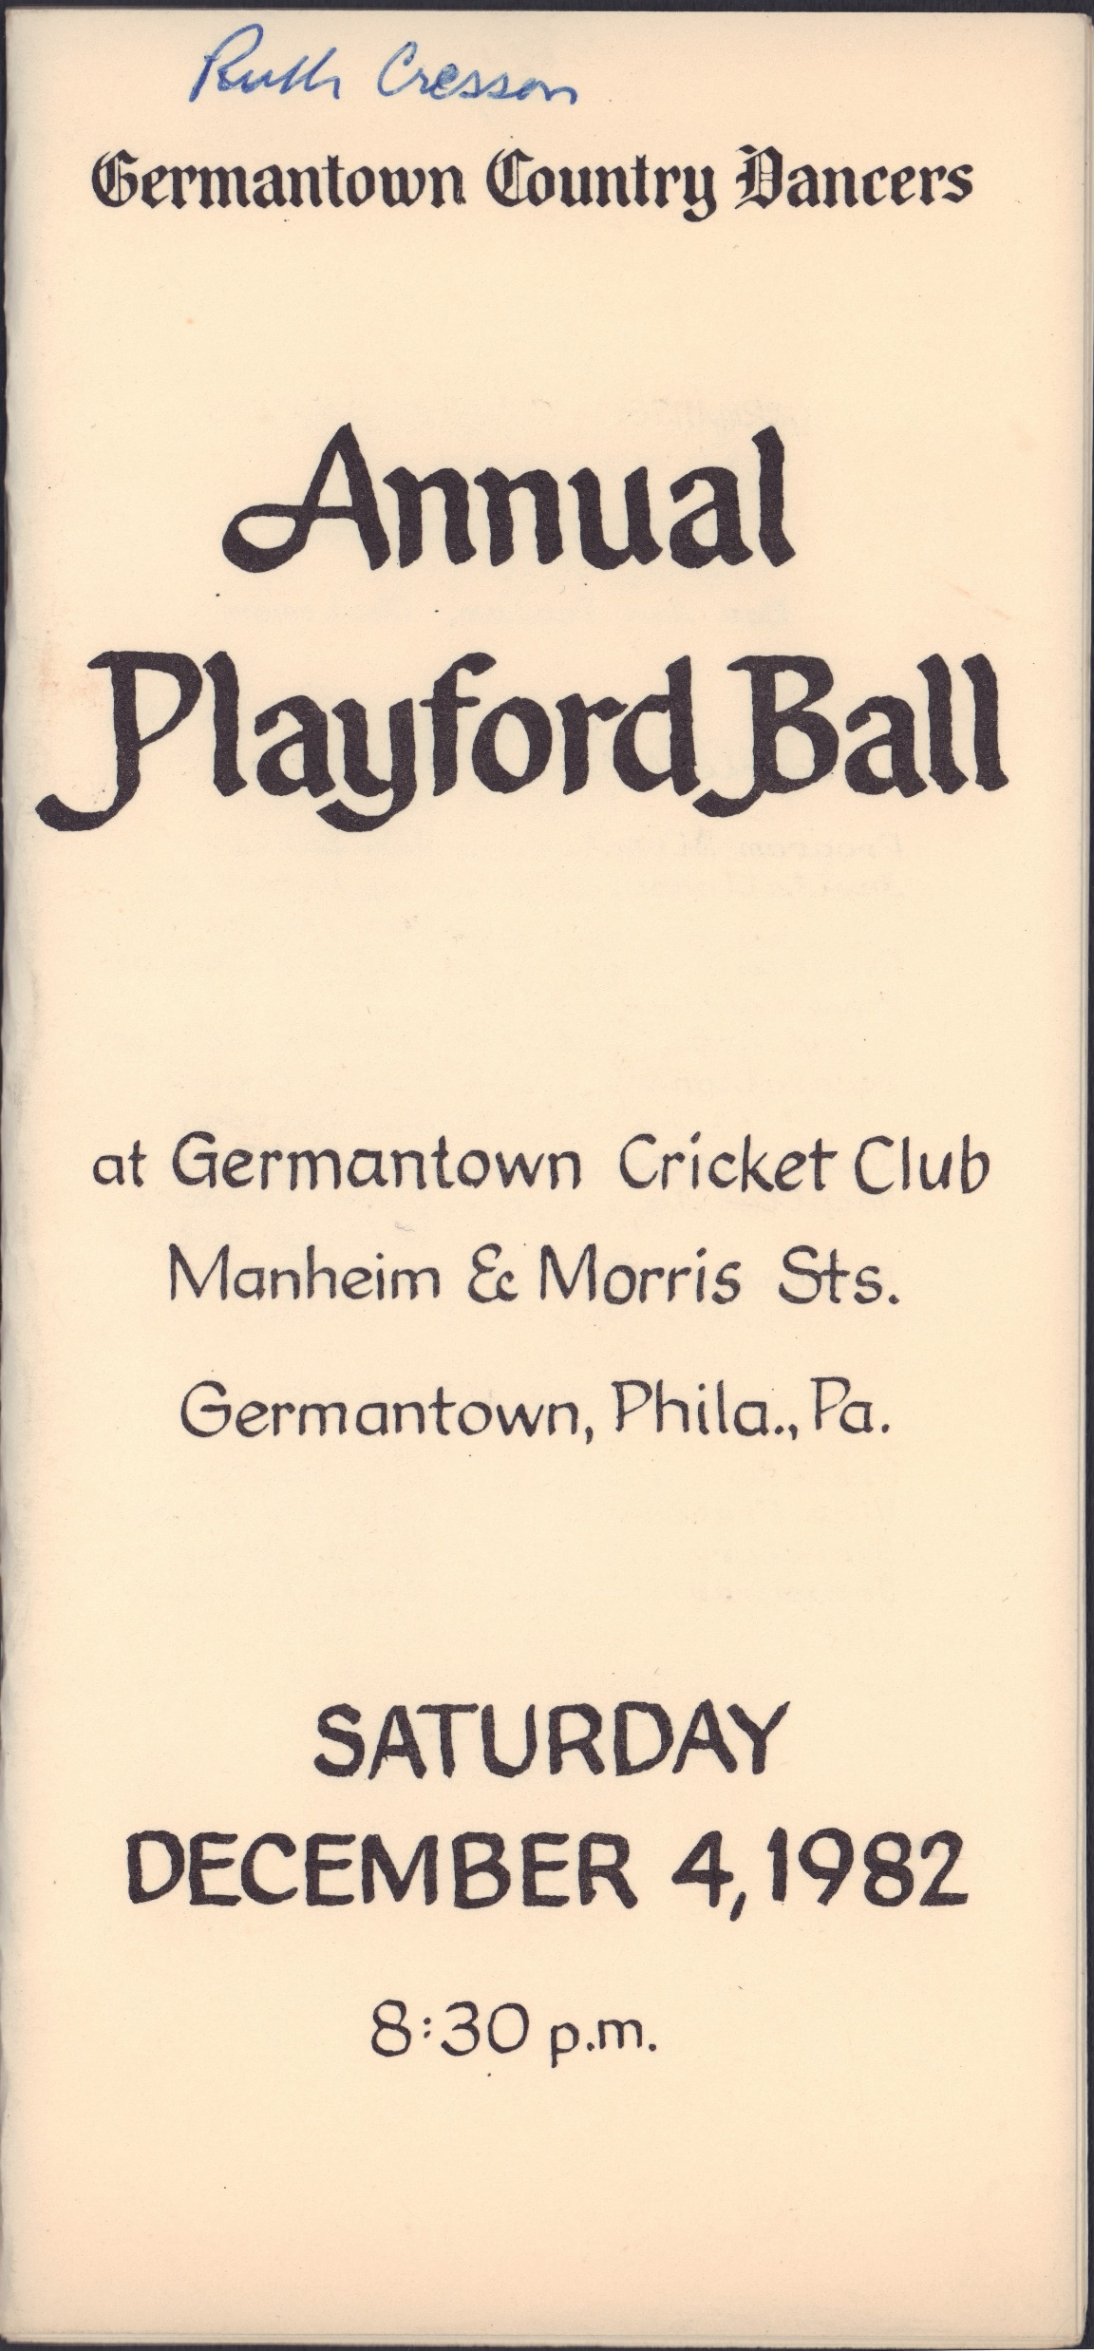
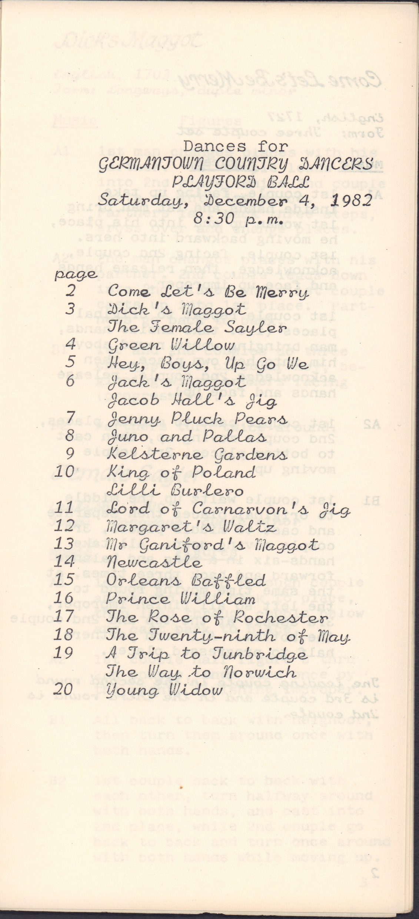
1982
Notes:
didn’t scan roles page

Slide 10
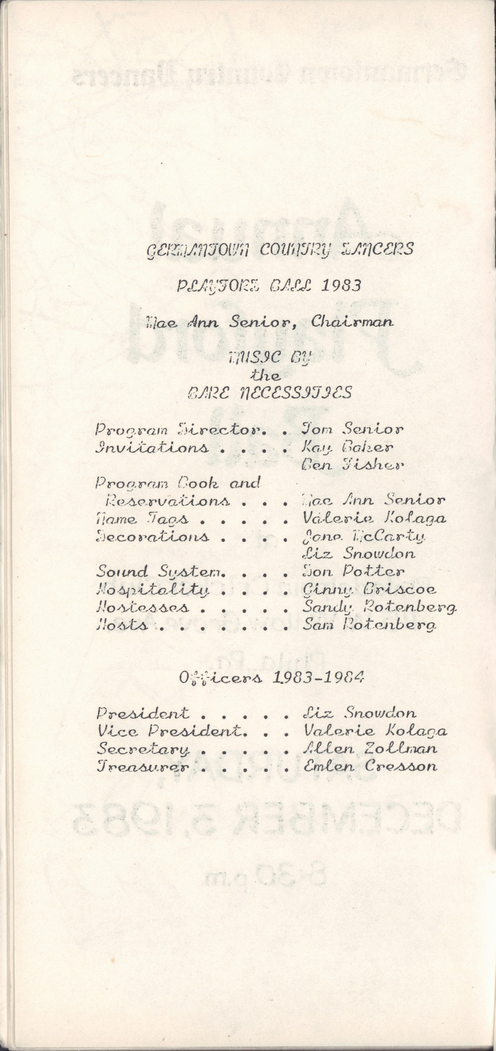
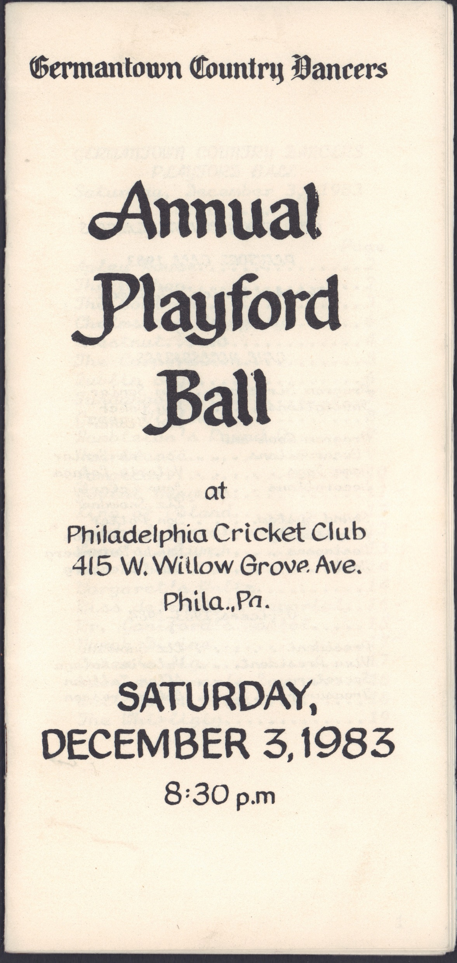
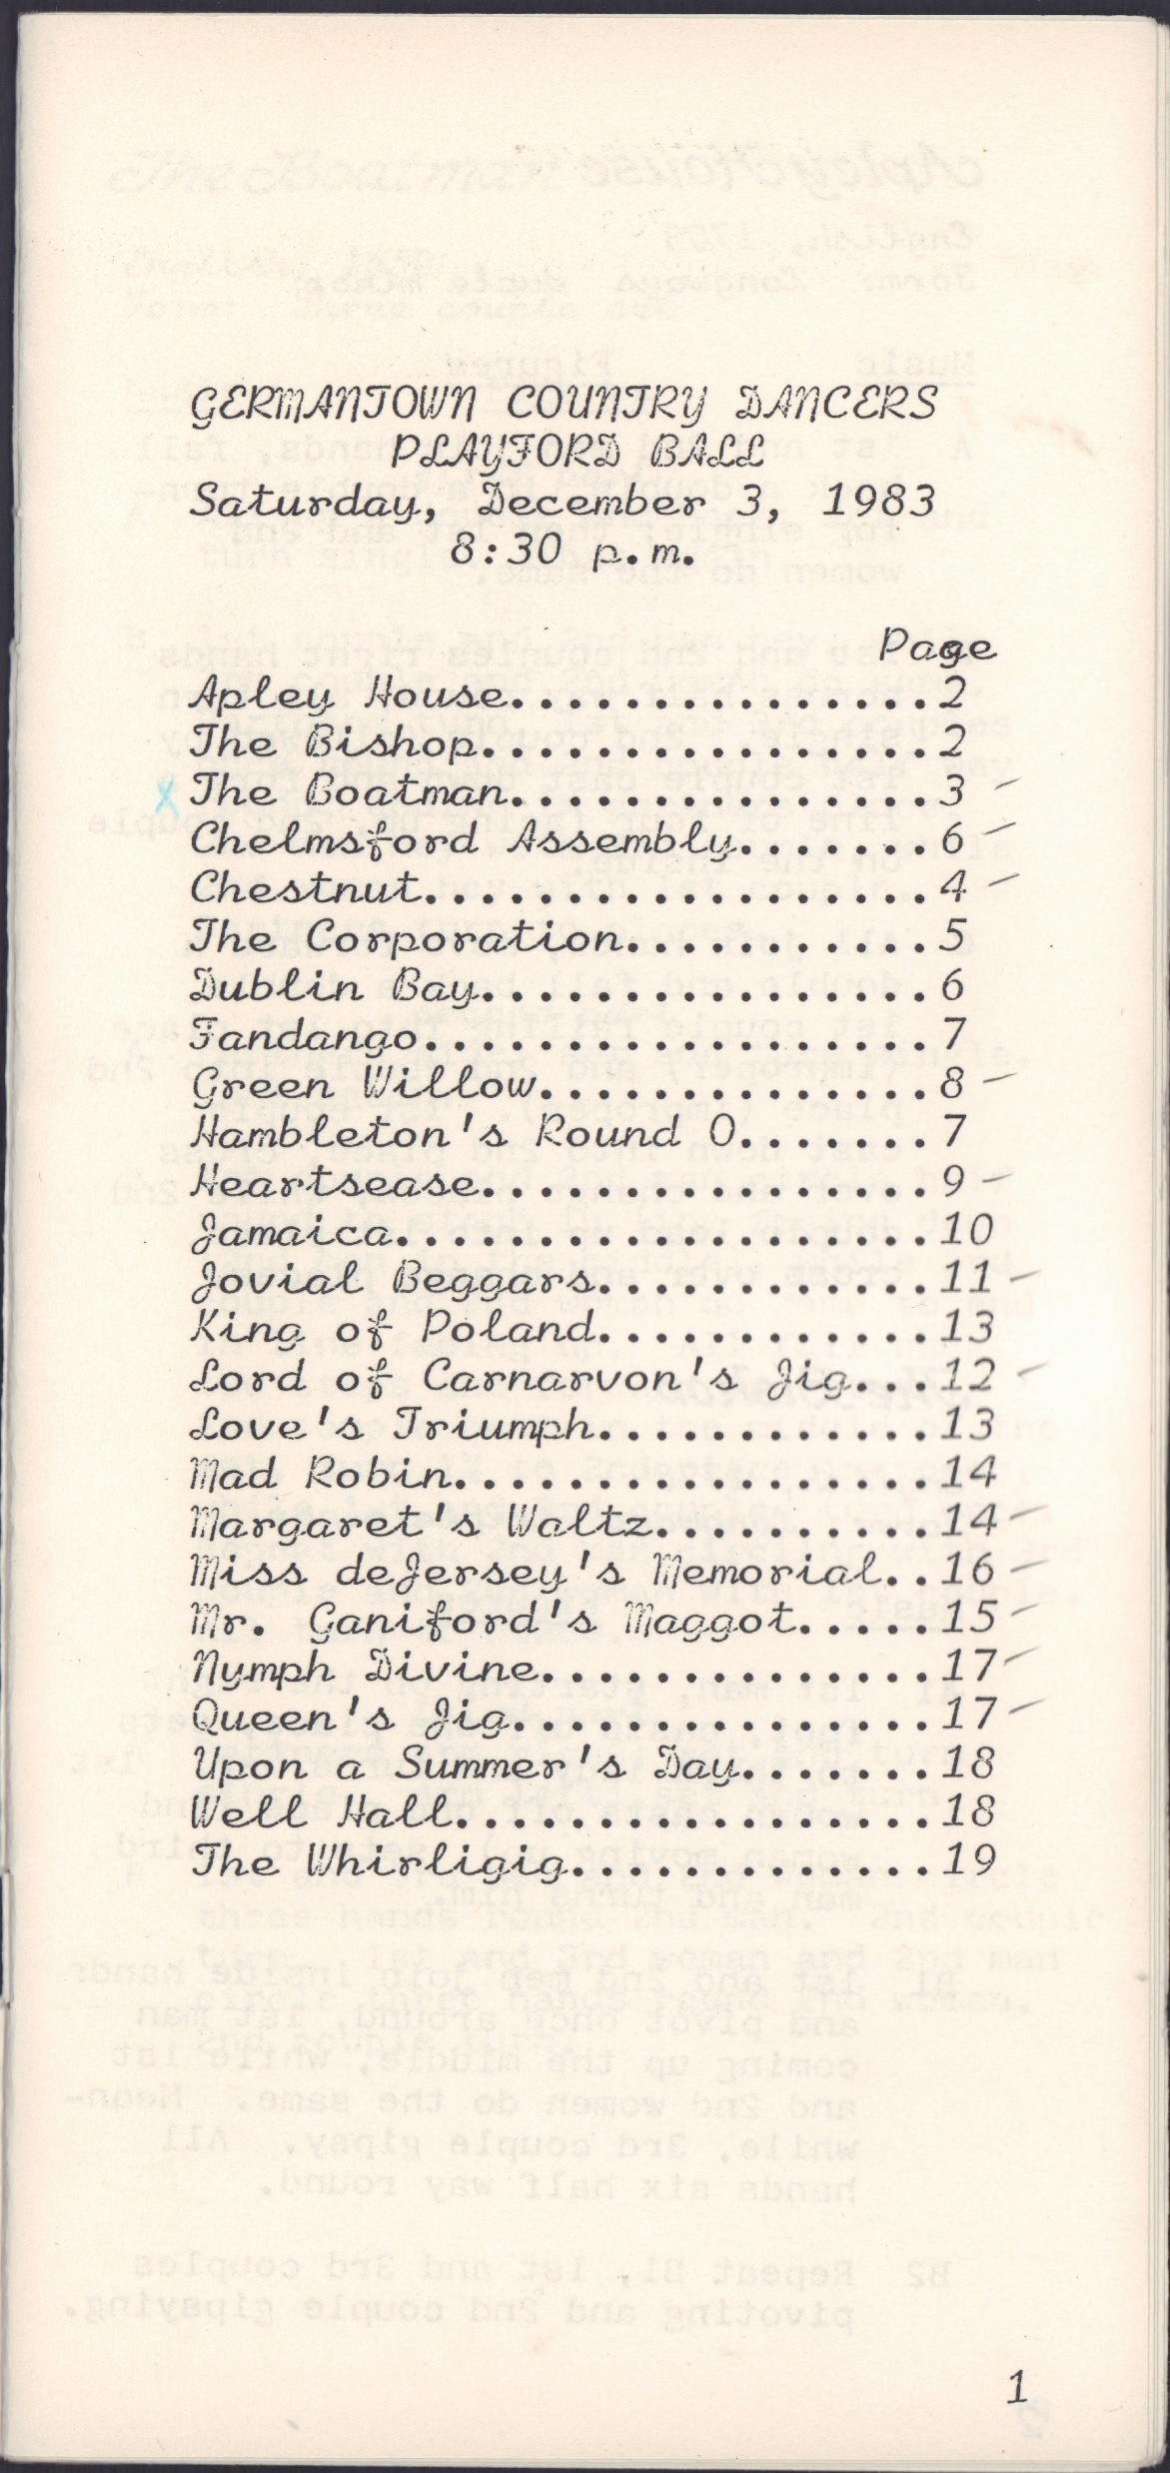
1983

Slide 11
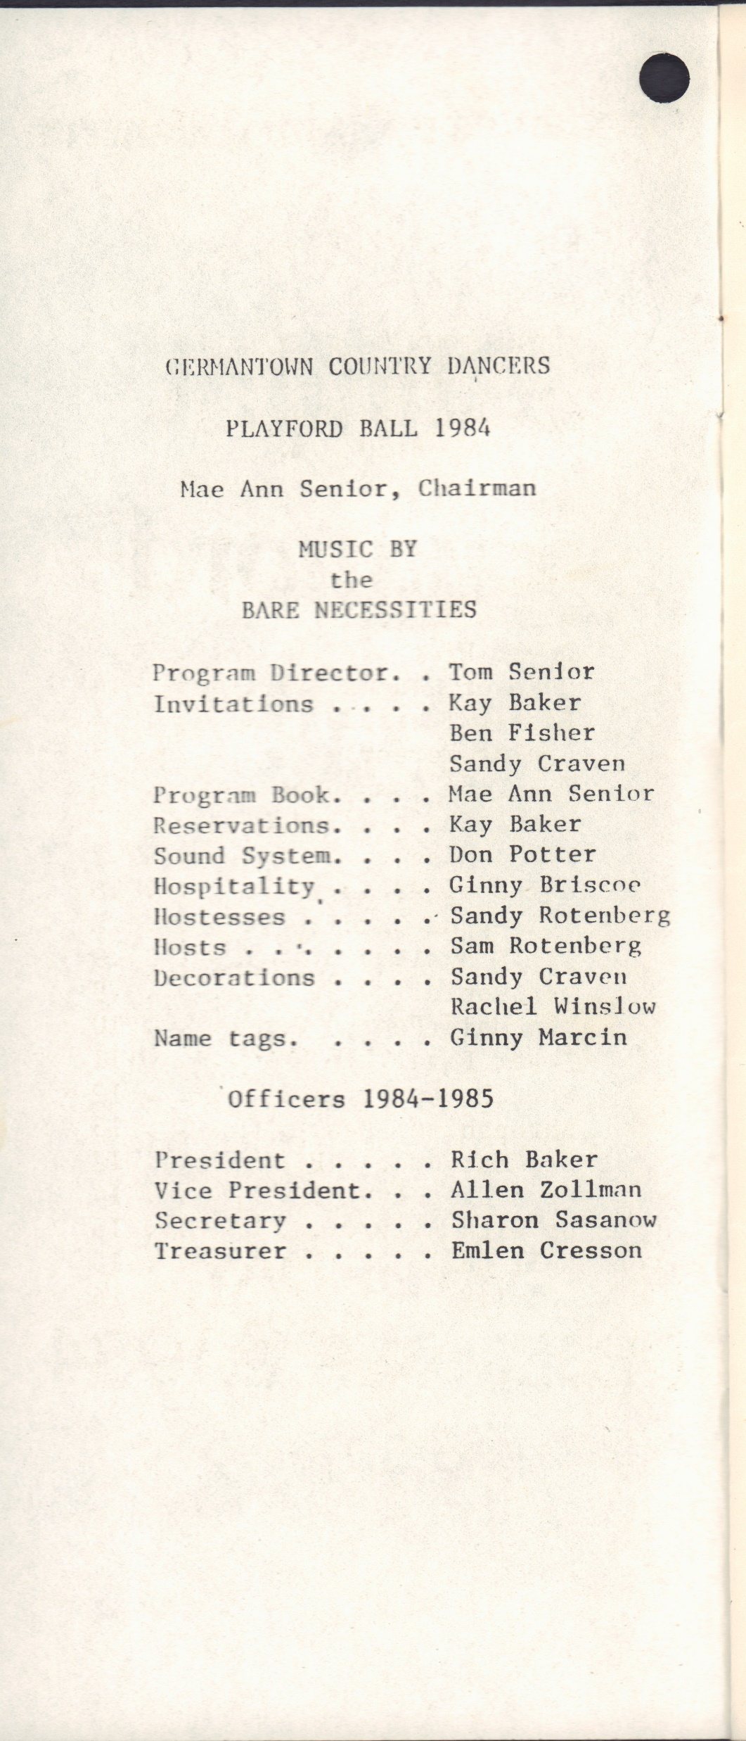
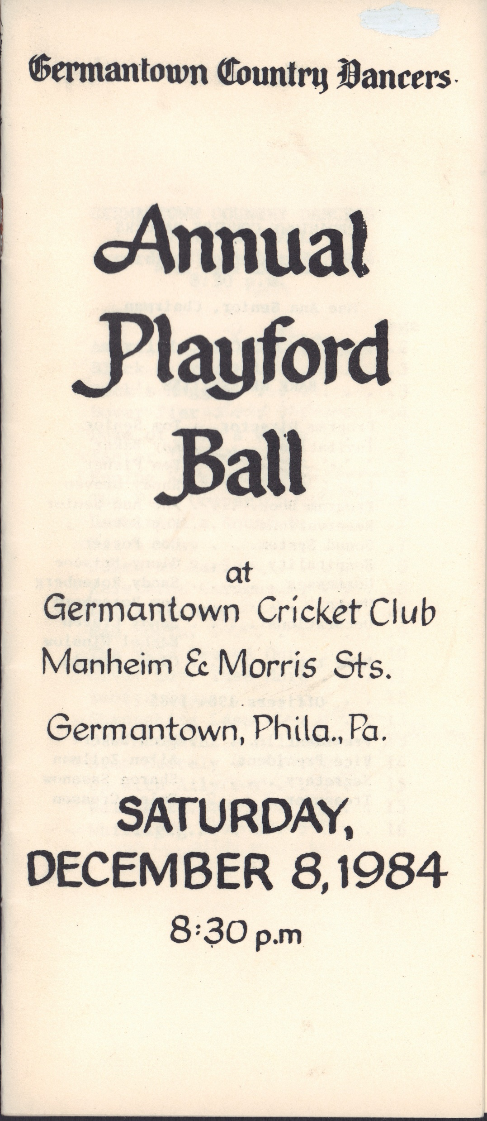
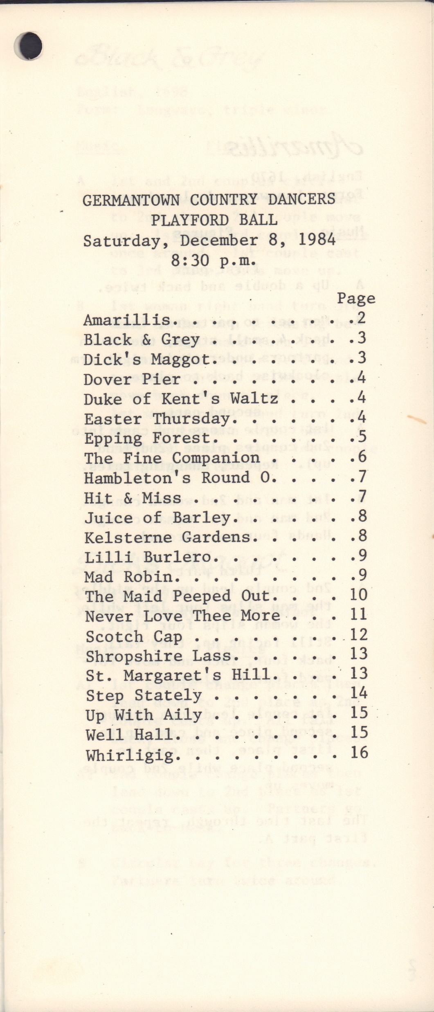
1984

Slide 12
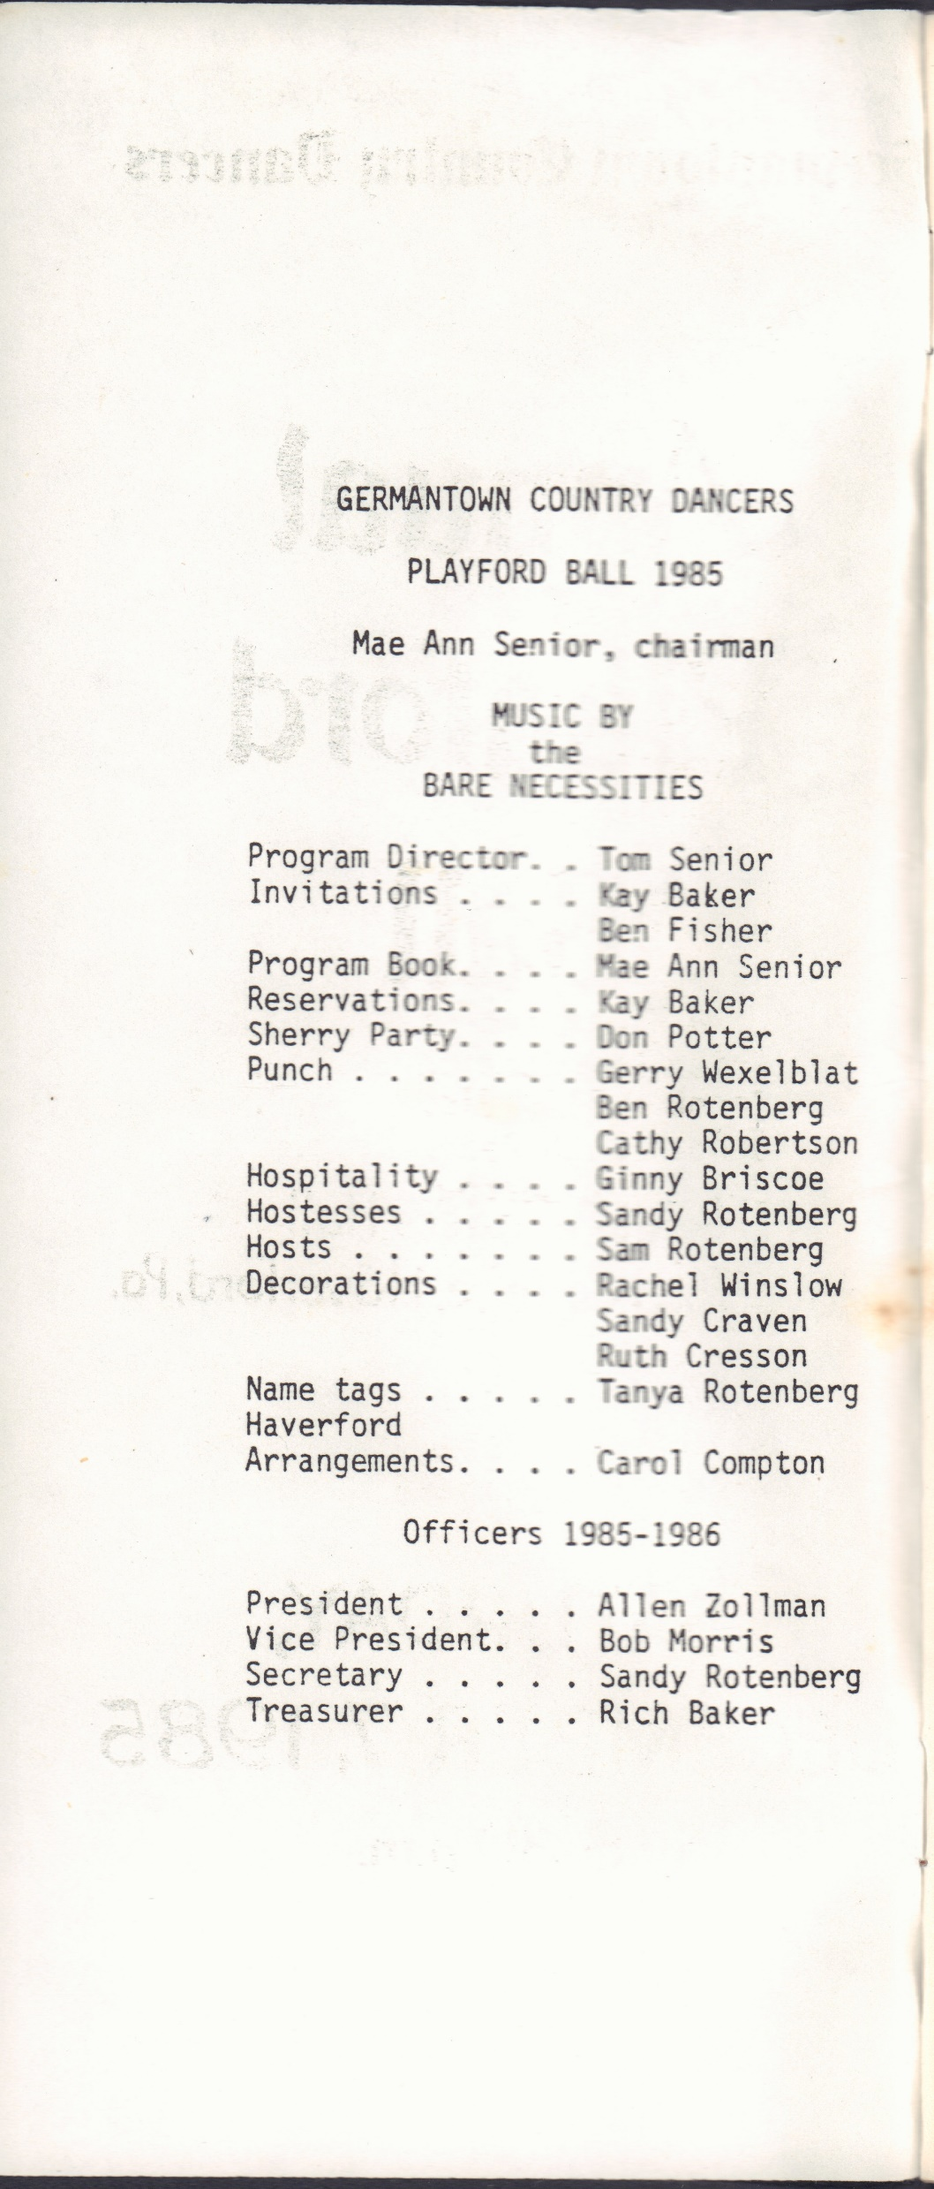
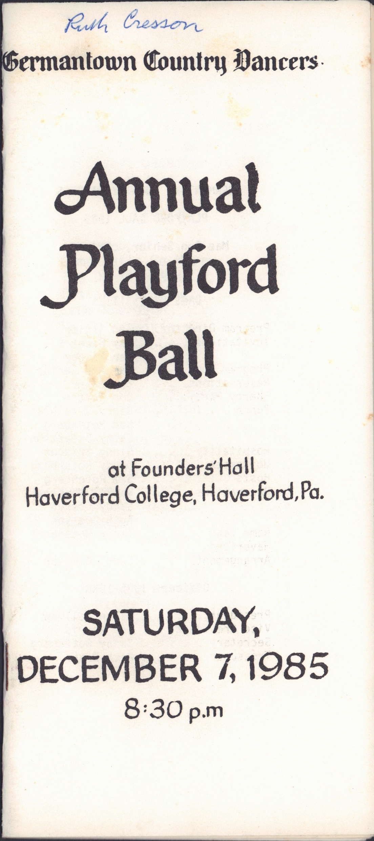
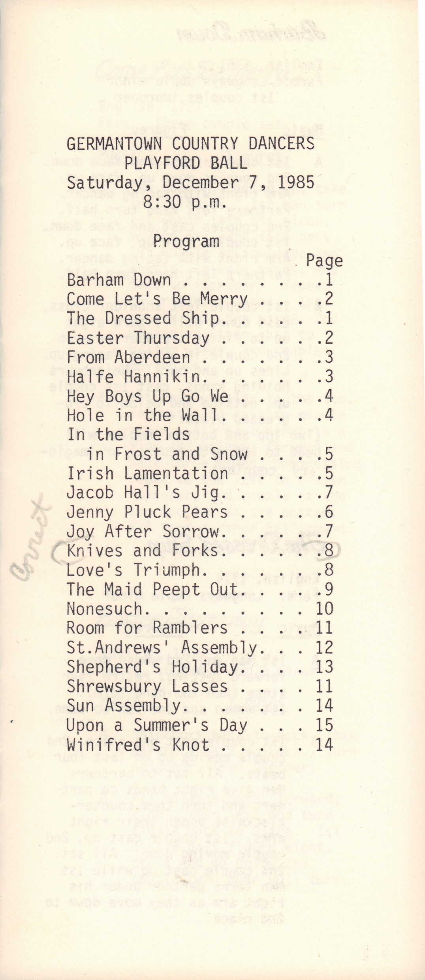
1985

Slide 13
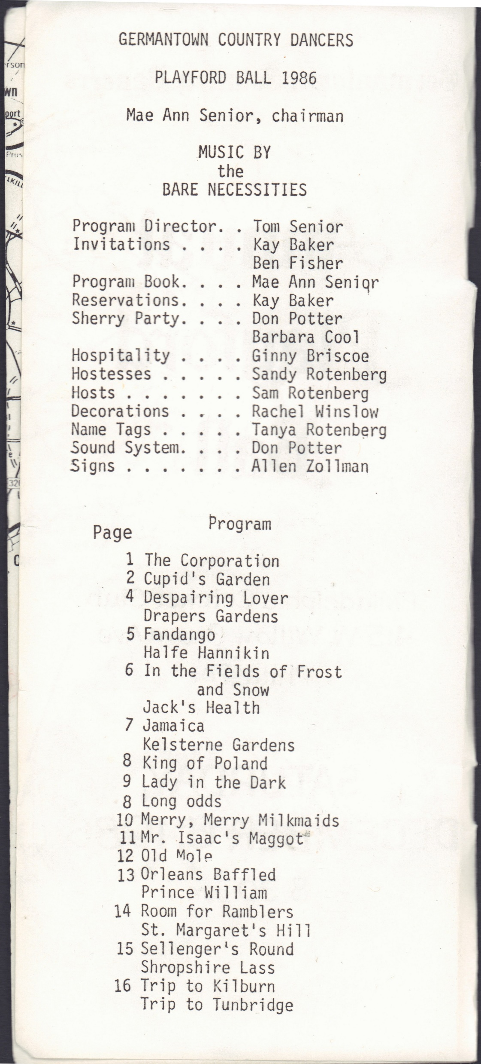
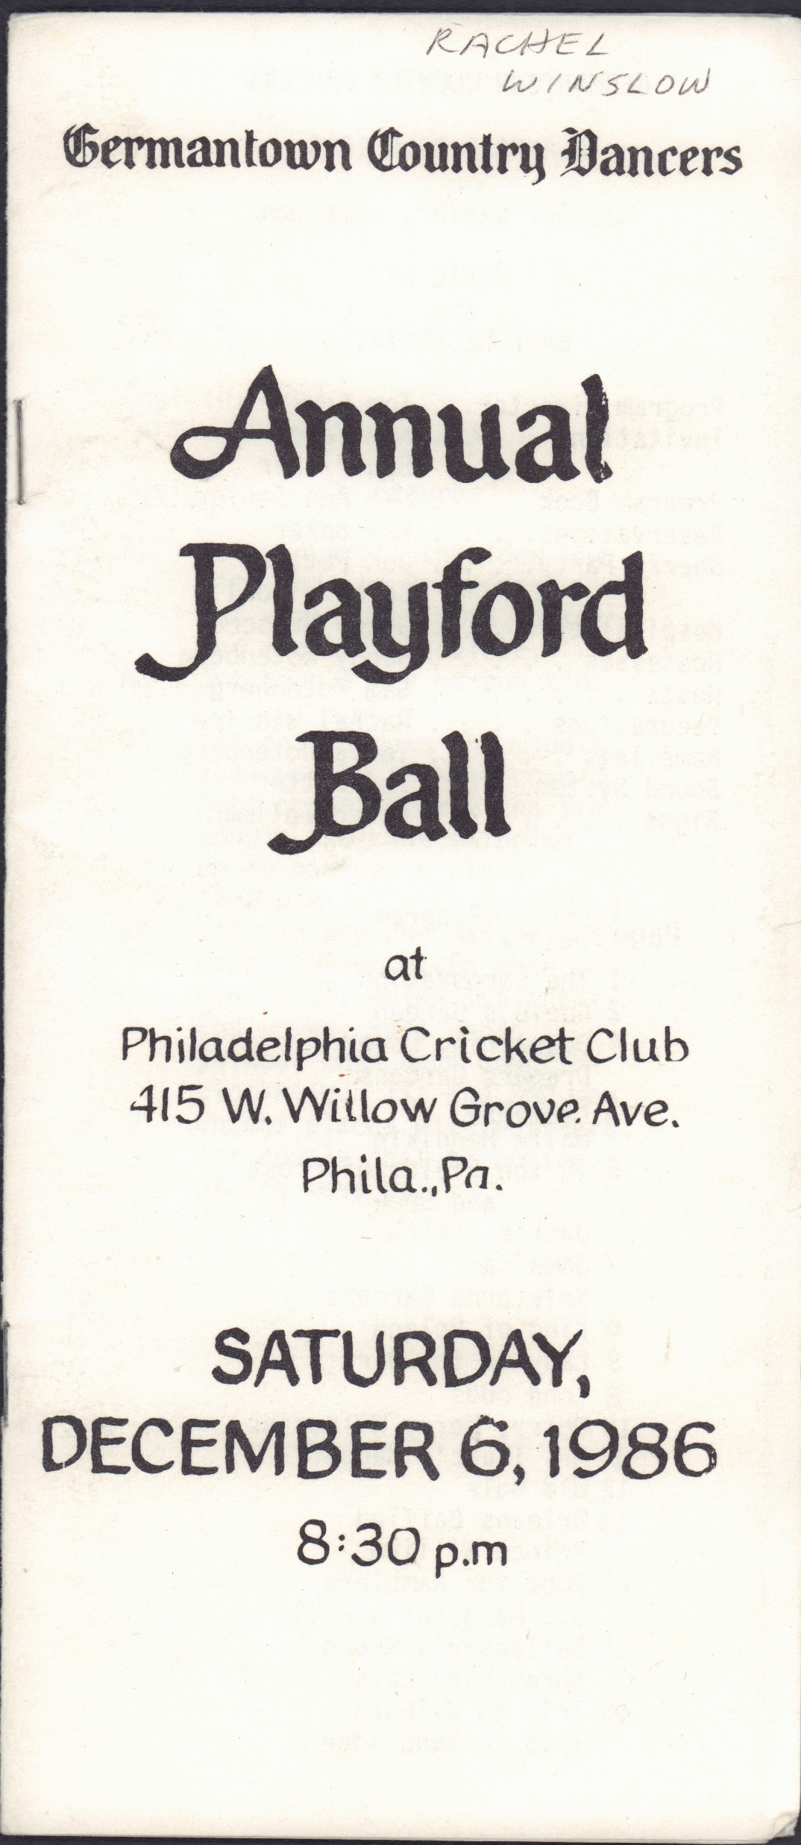
1986

Slide 14
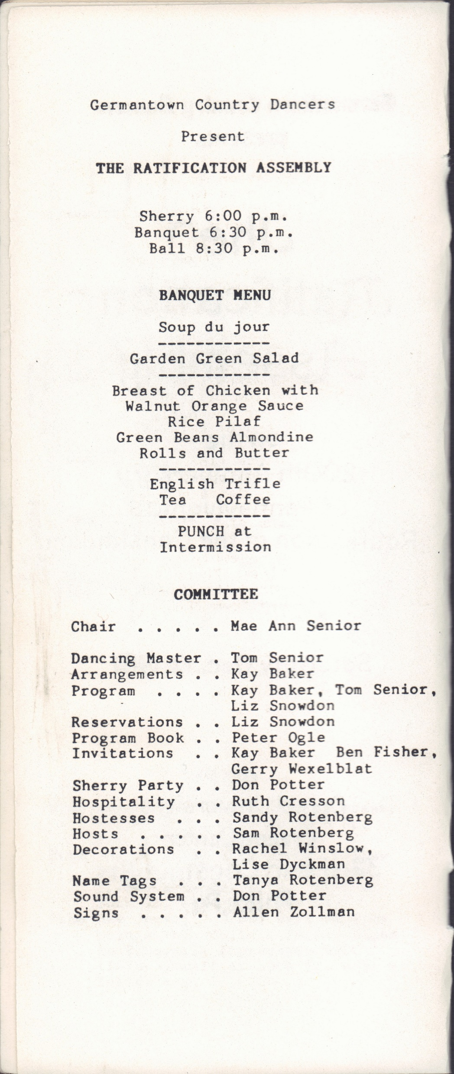
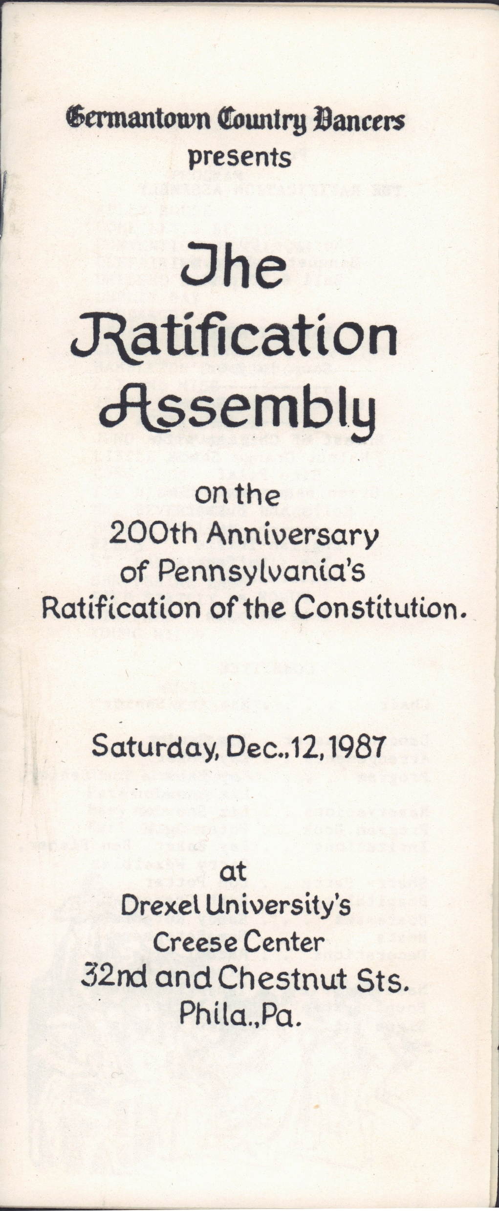
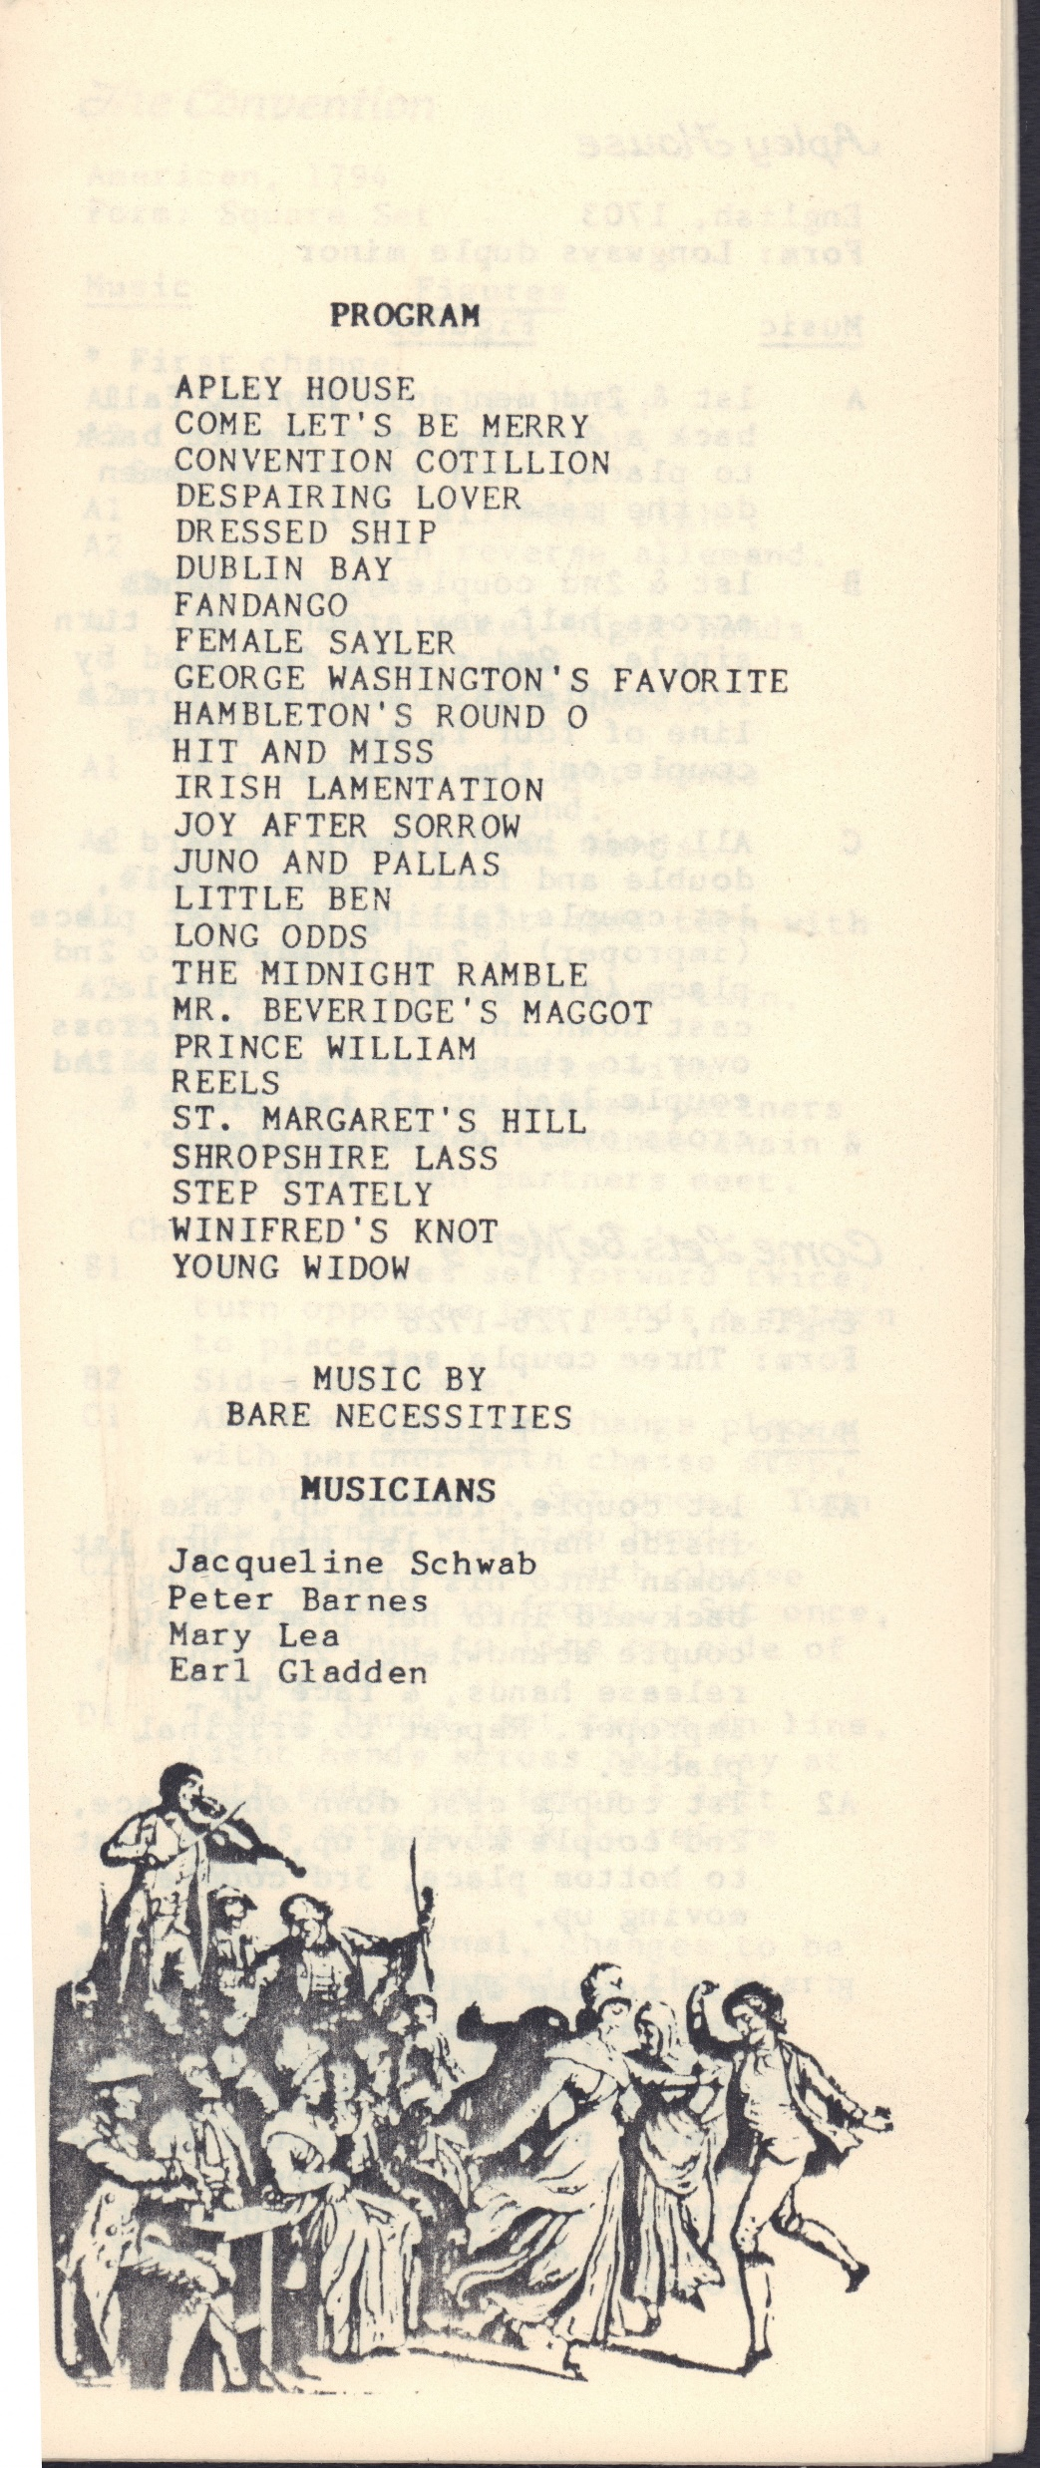
1987

Slide 15
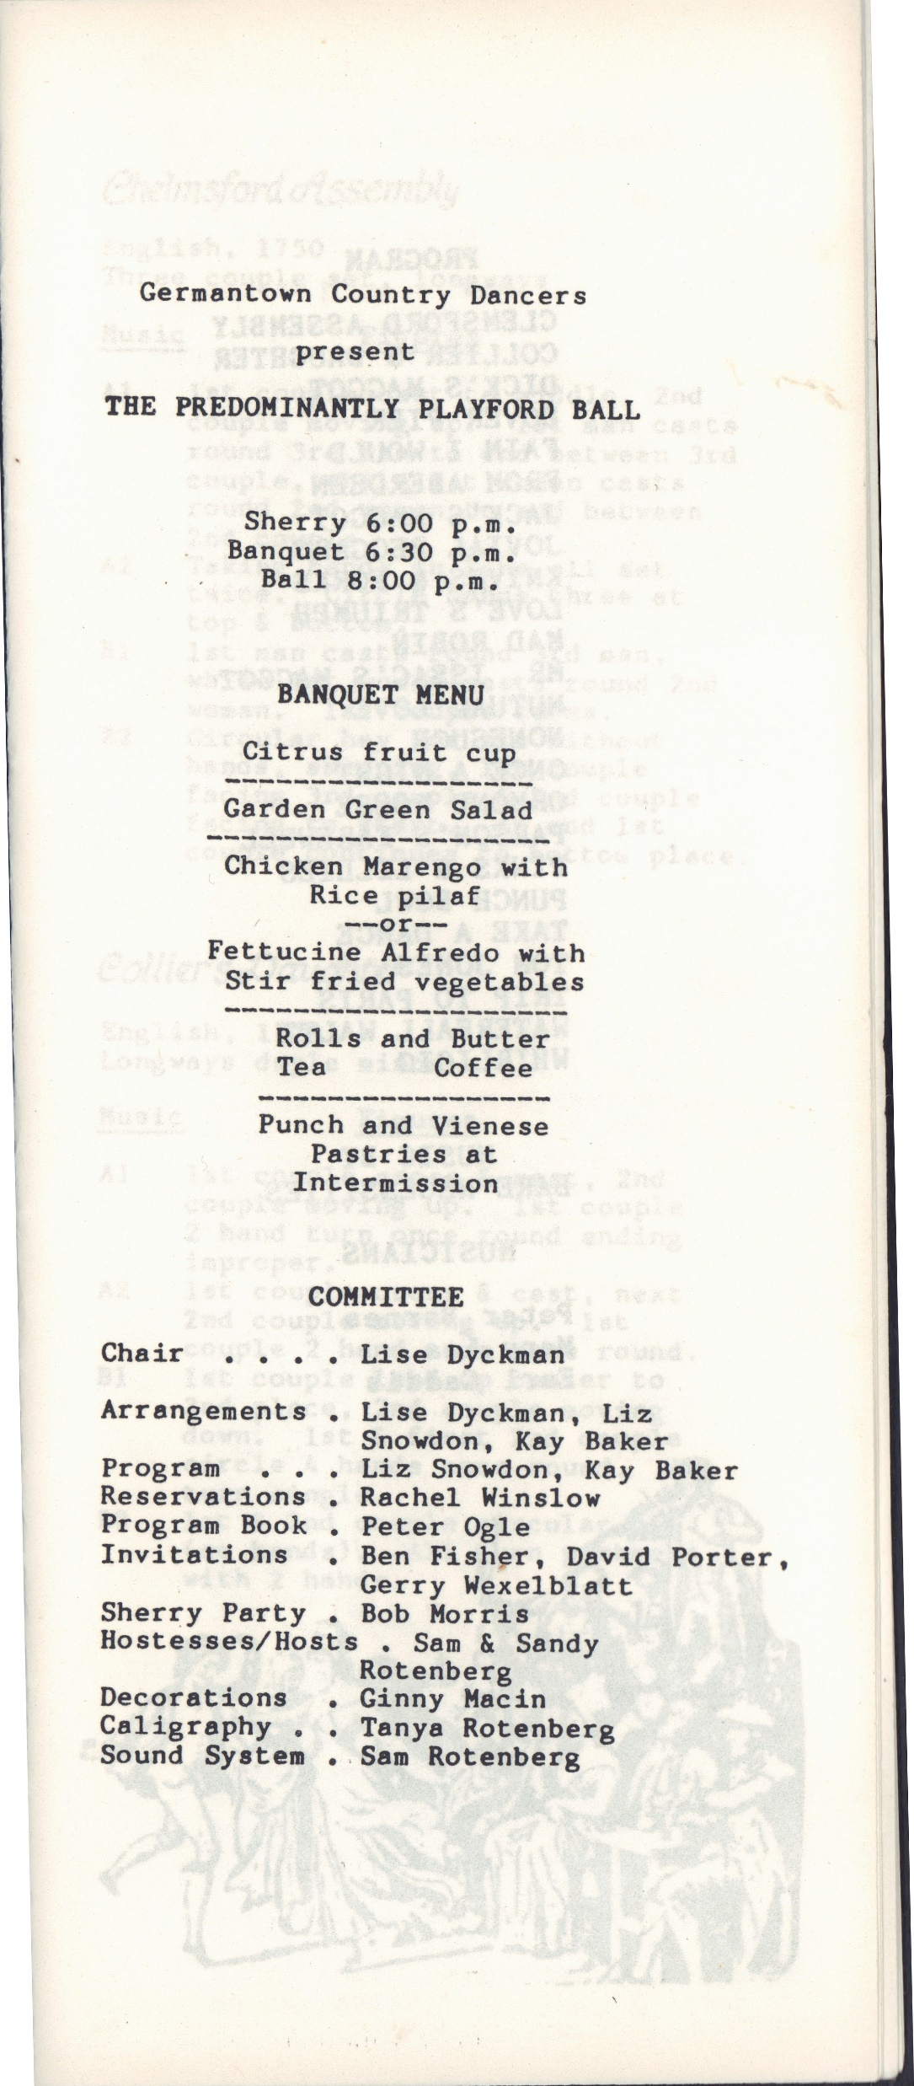
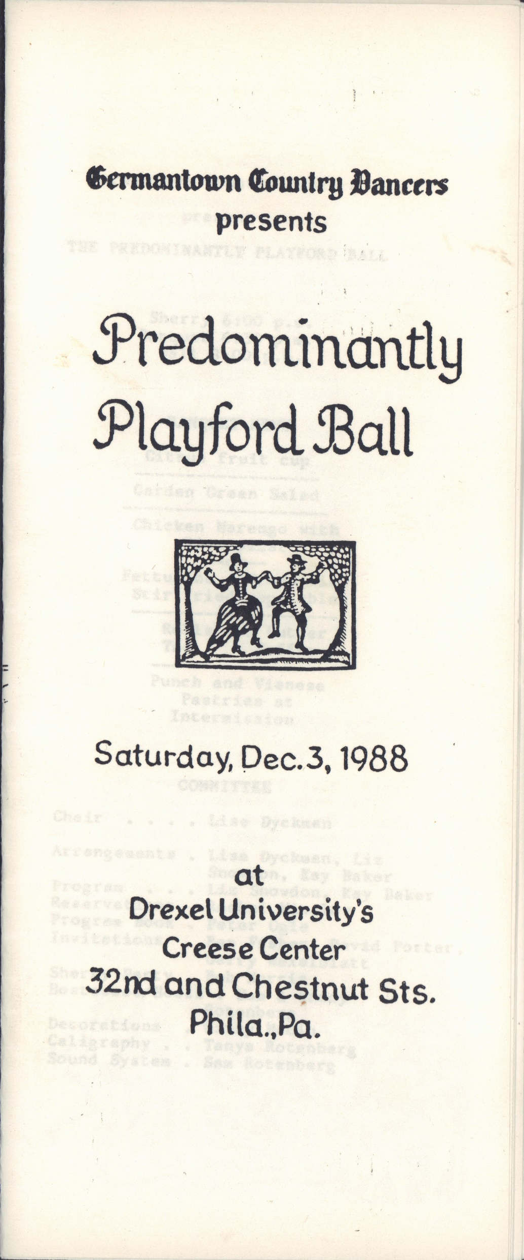
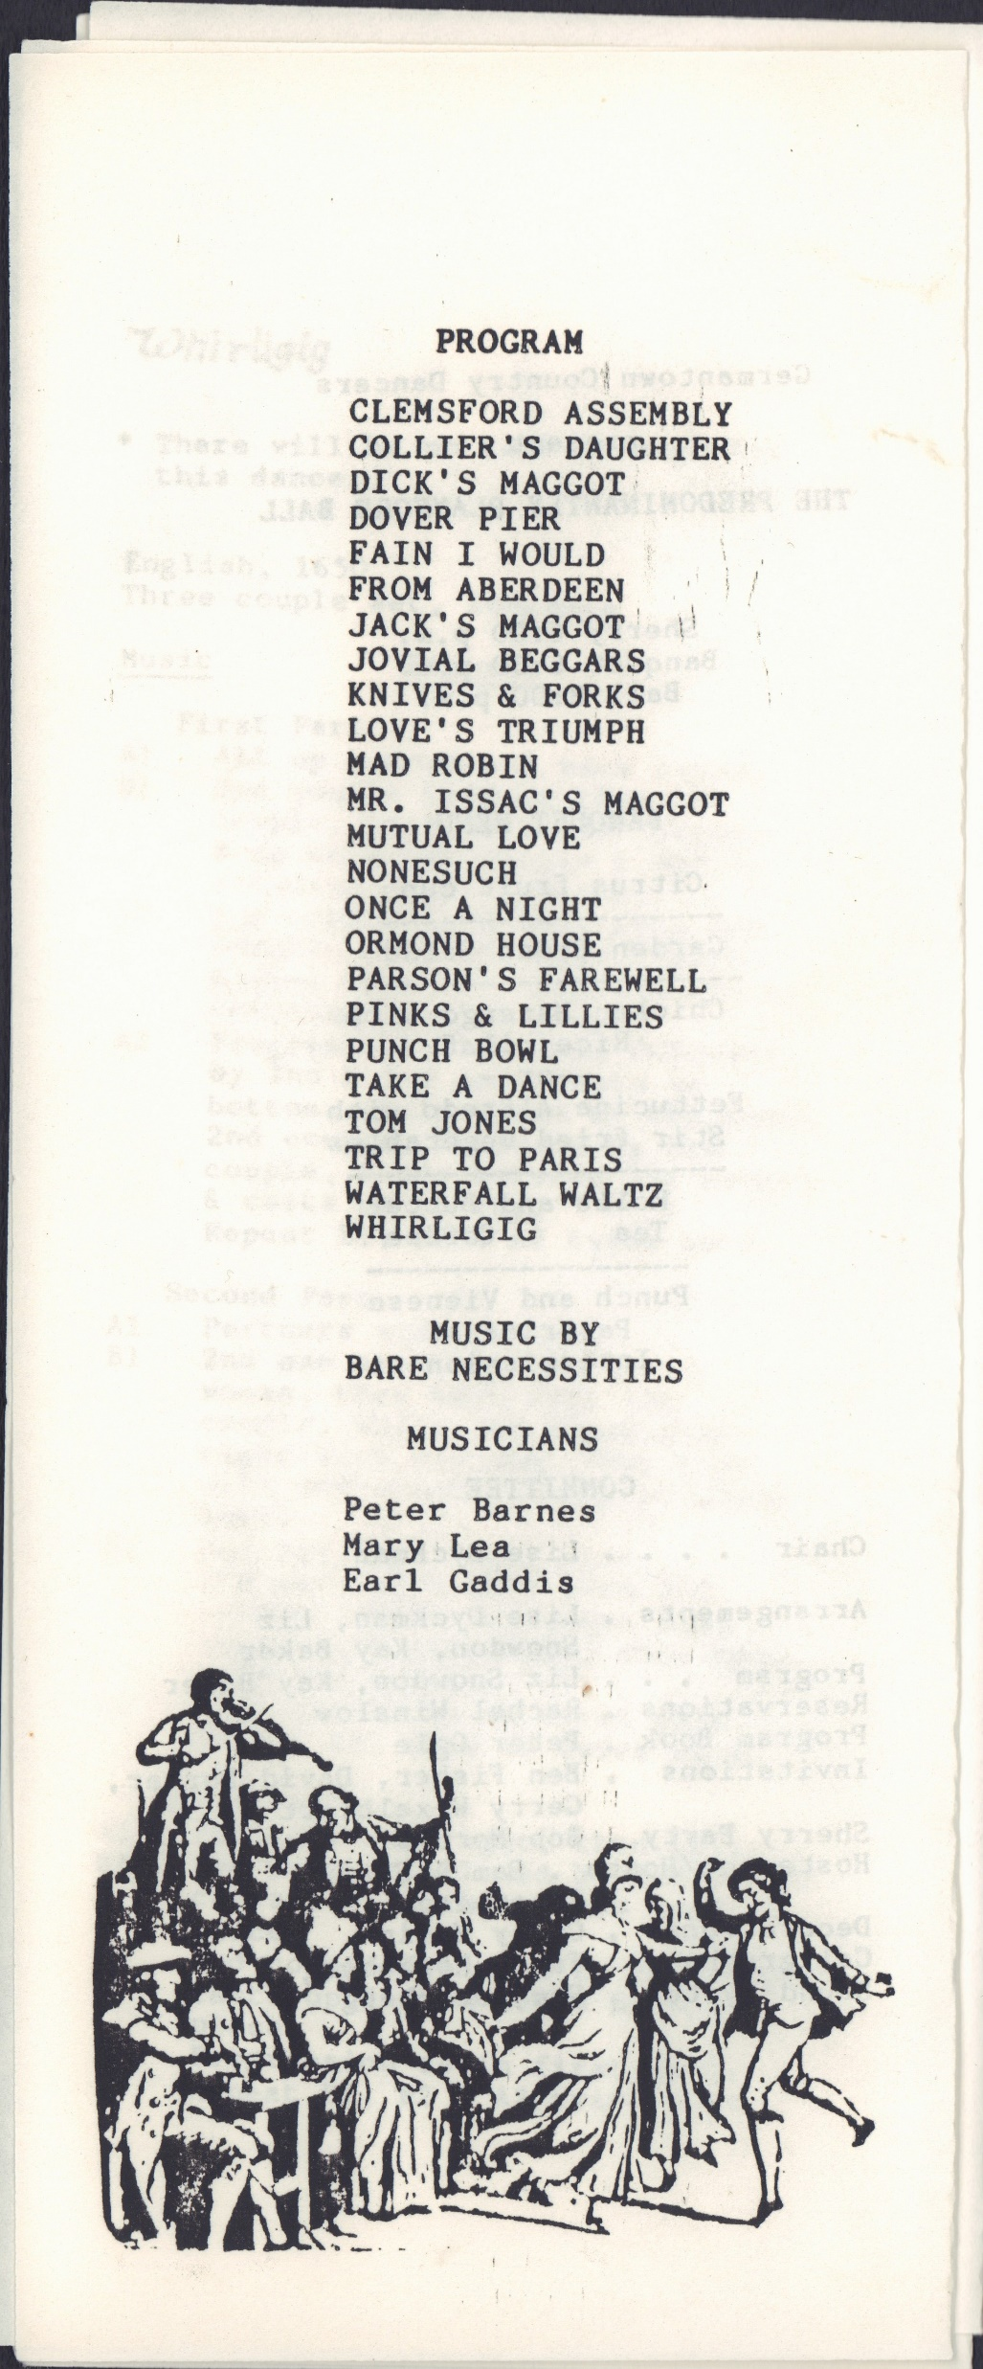
1988

Slide 16
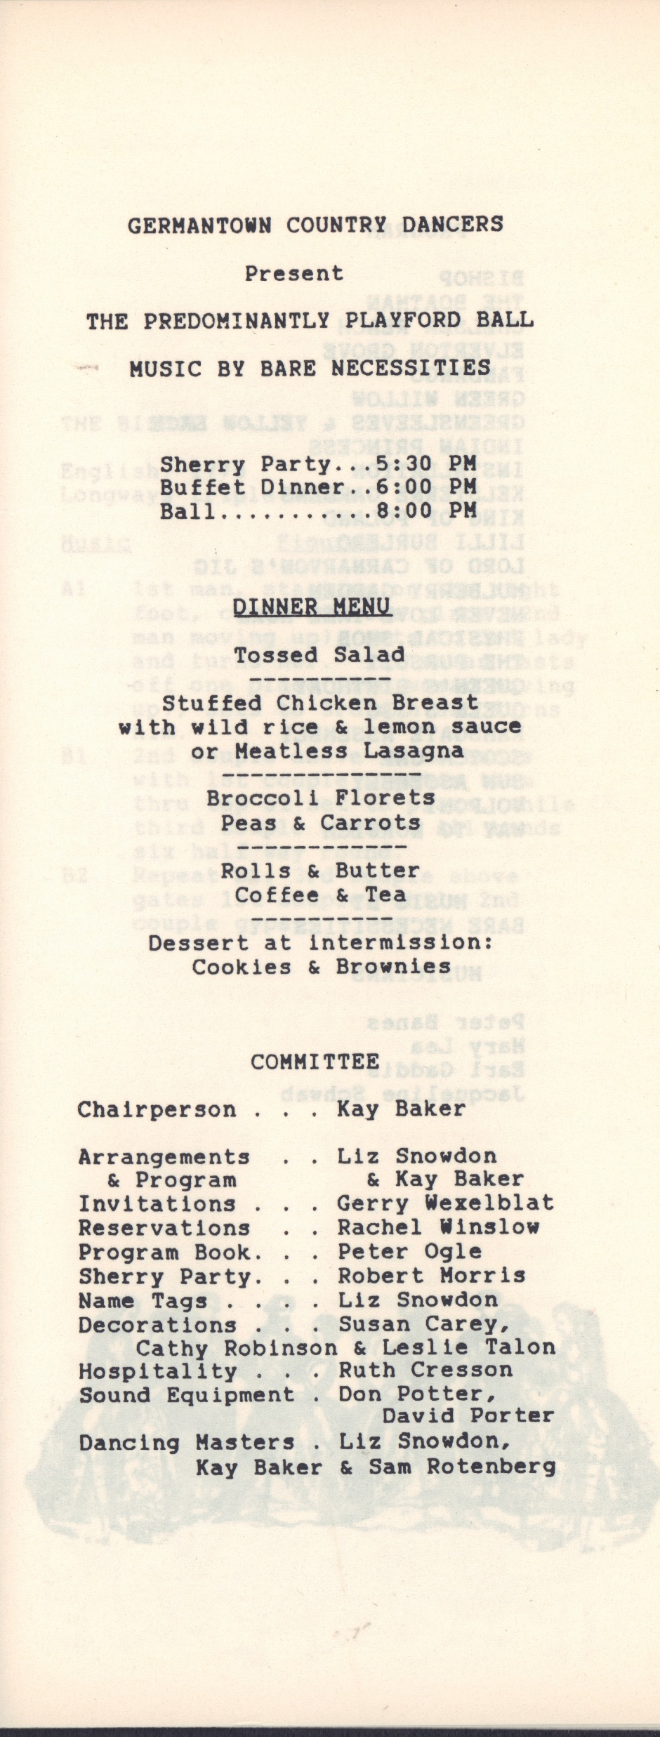
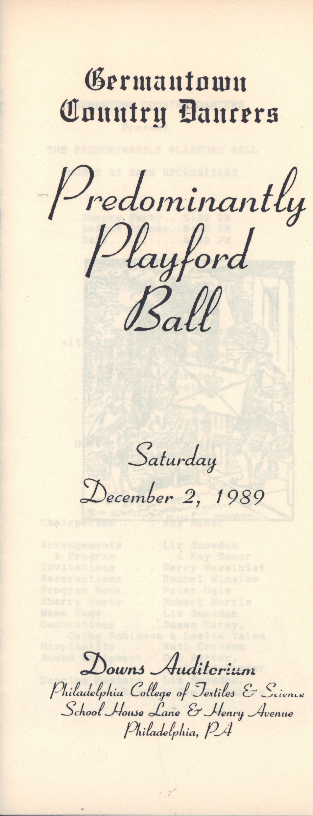
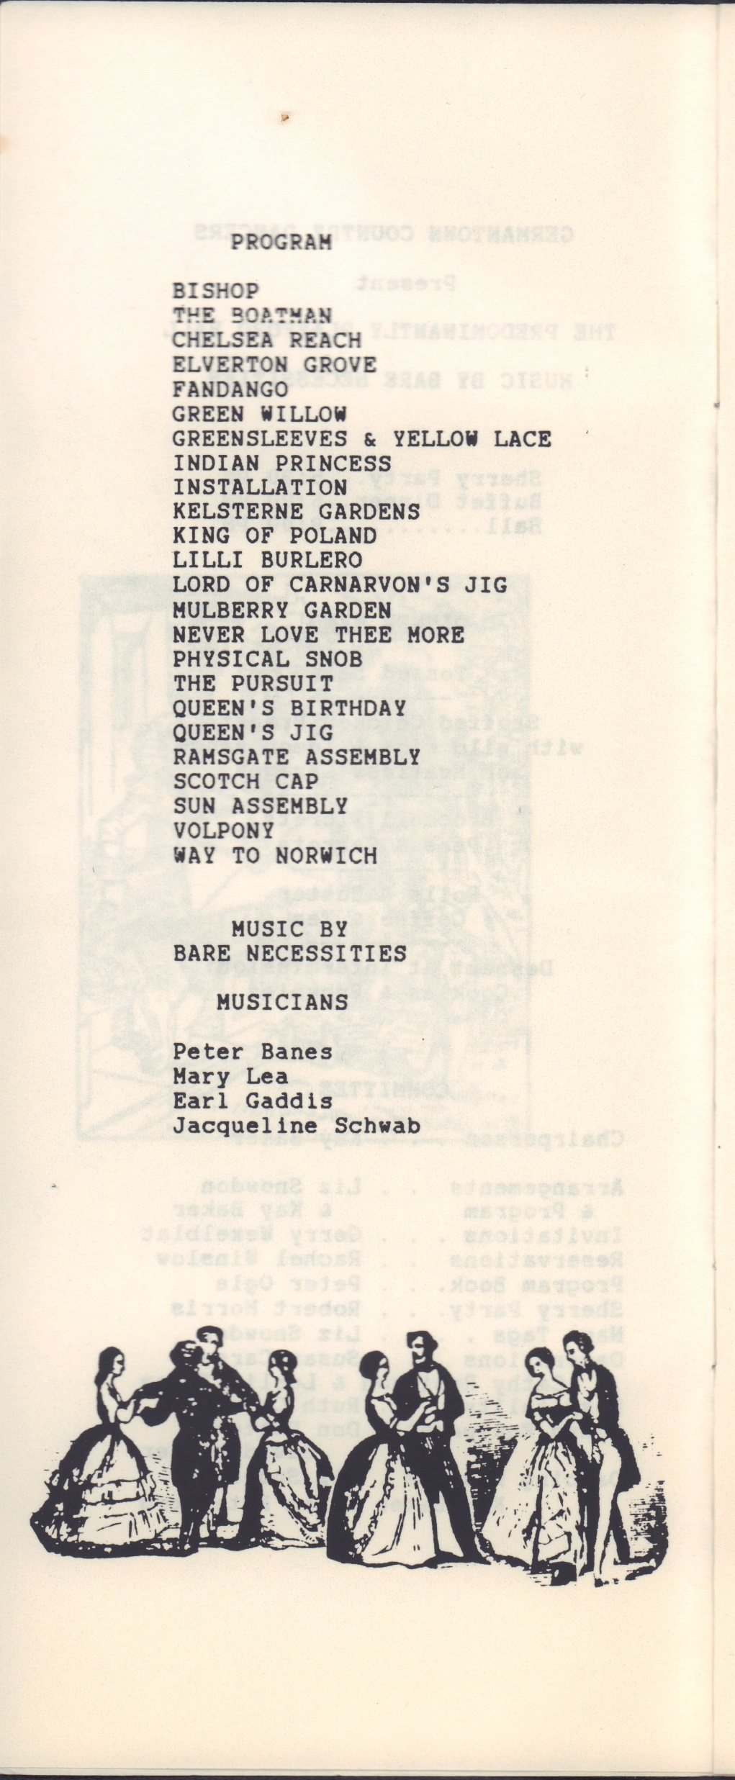
1989

Slide 17
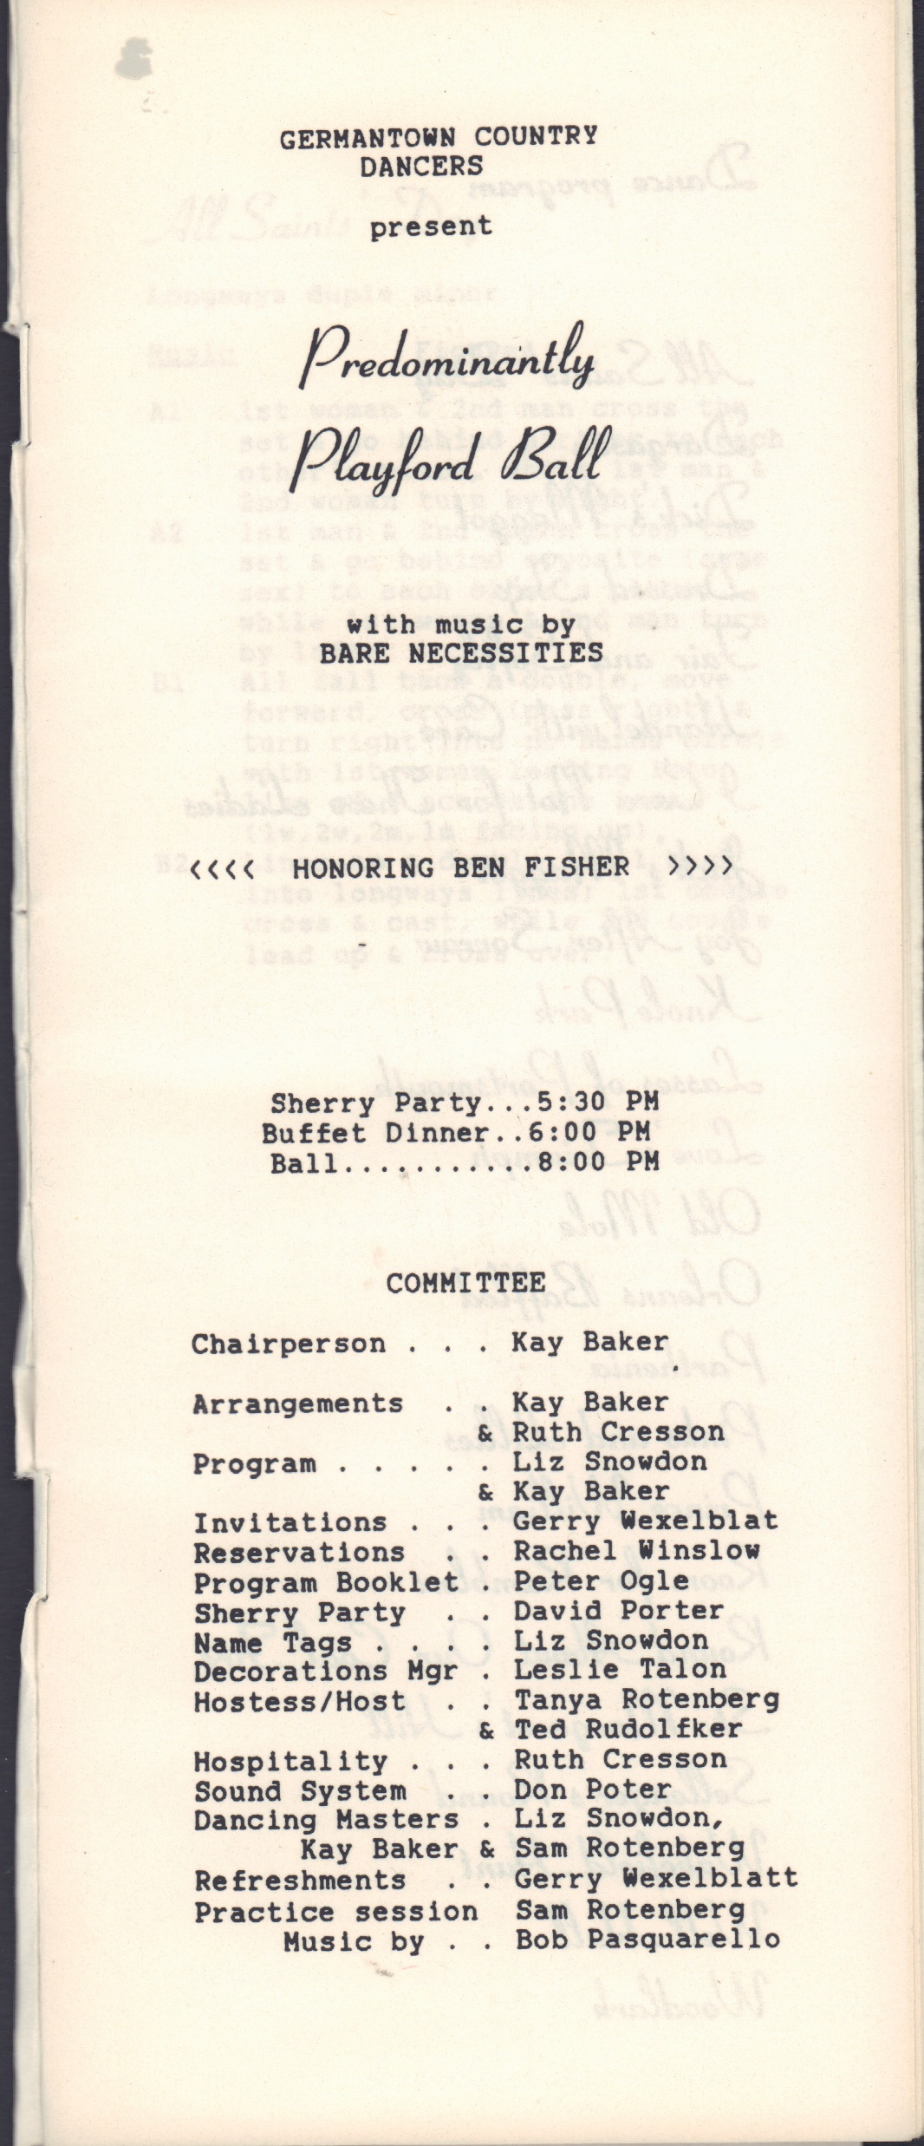
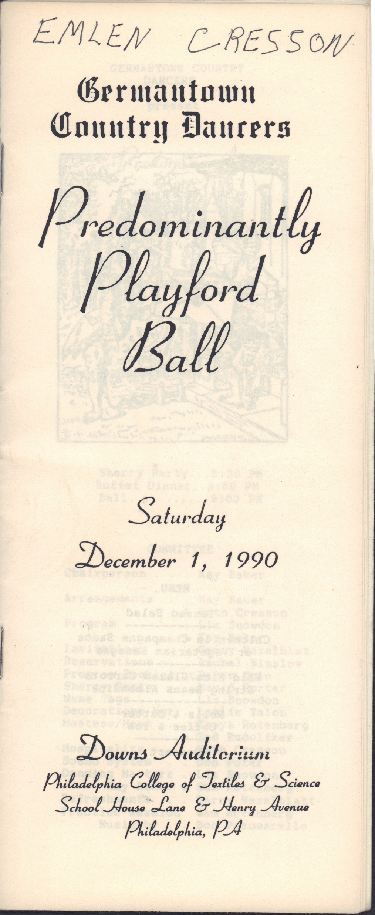
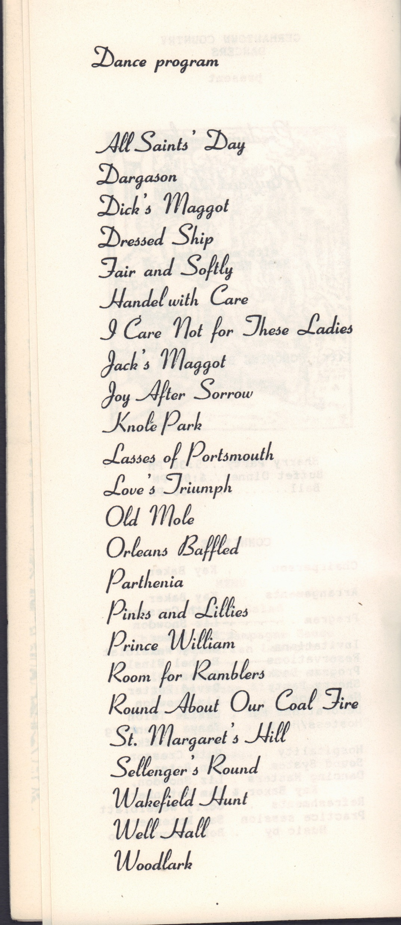
1990

Slide 18
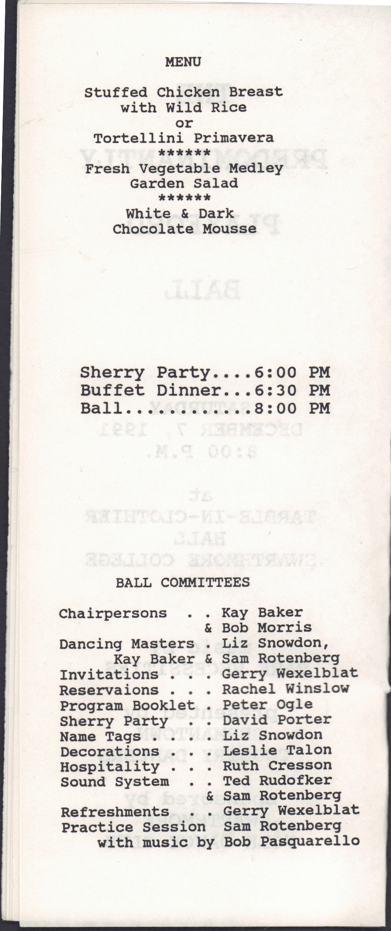
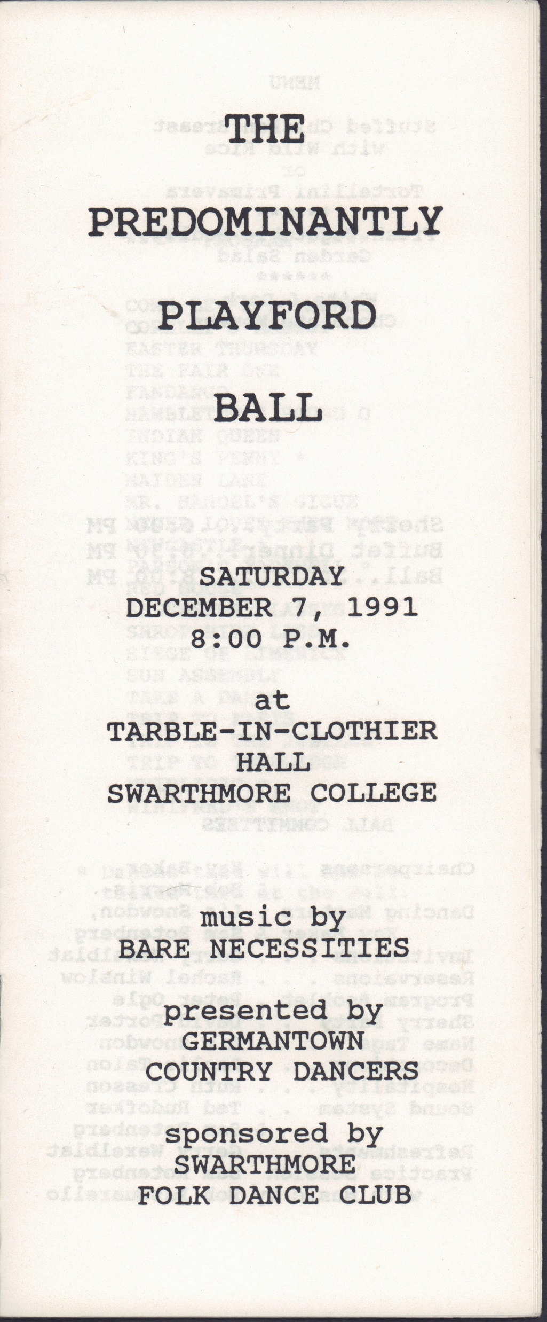
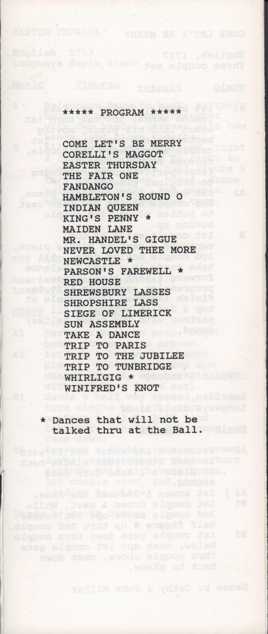
1991

Slide 19
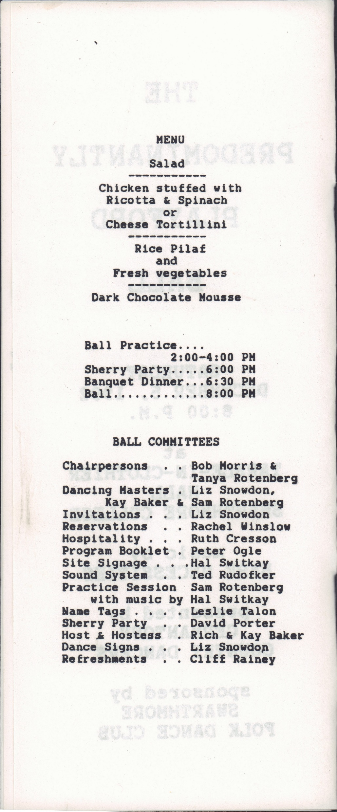
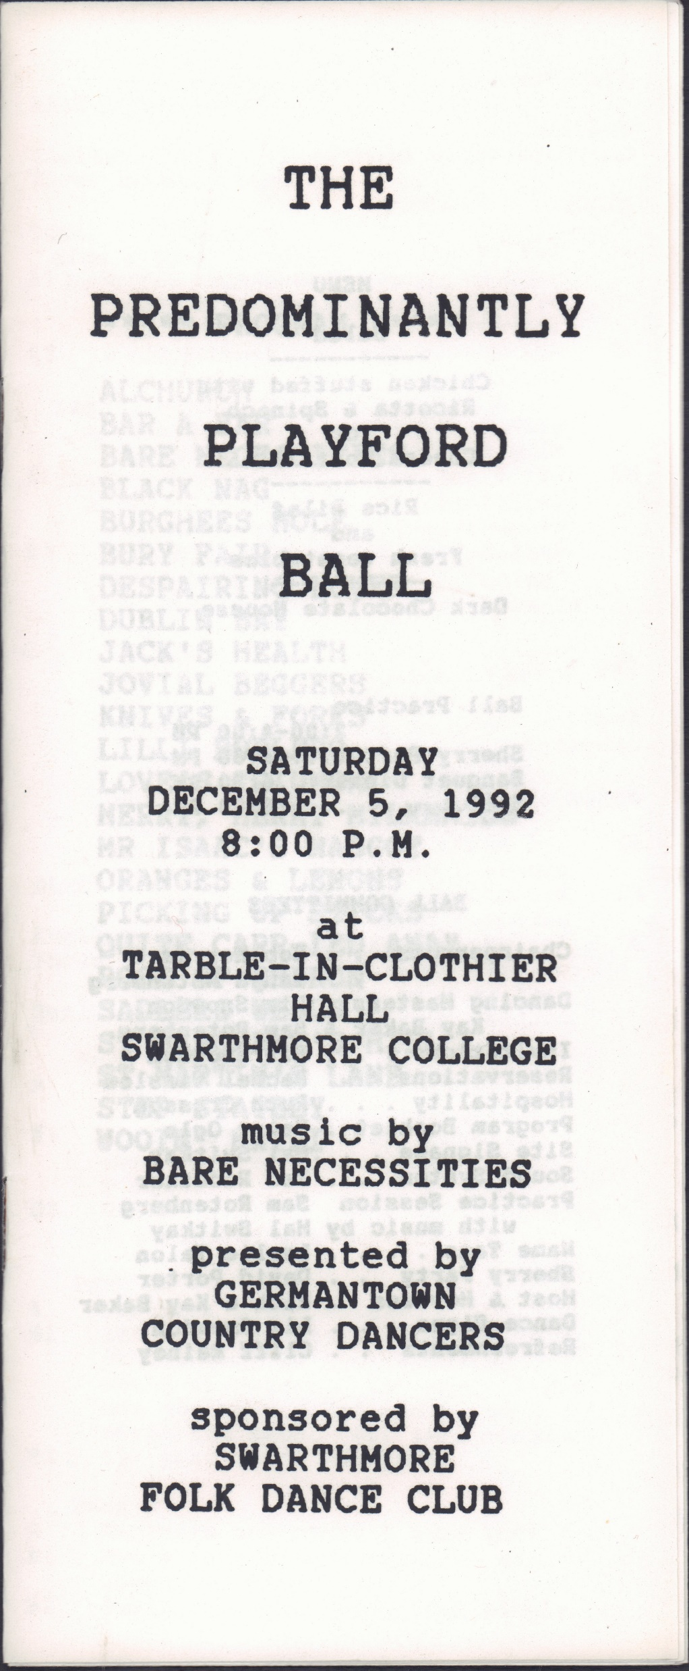
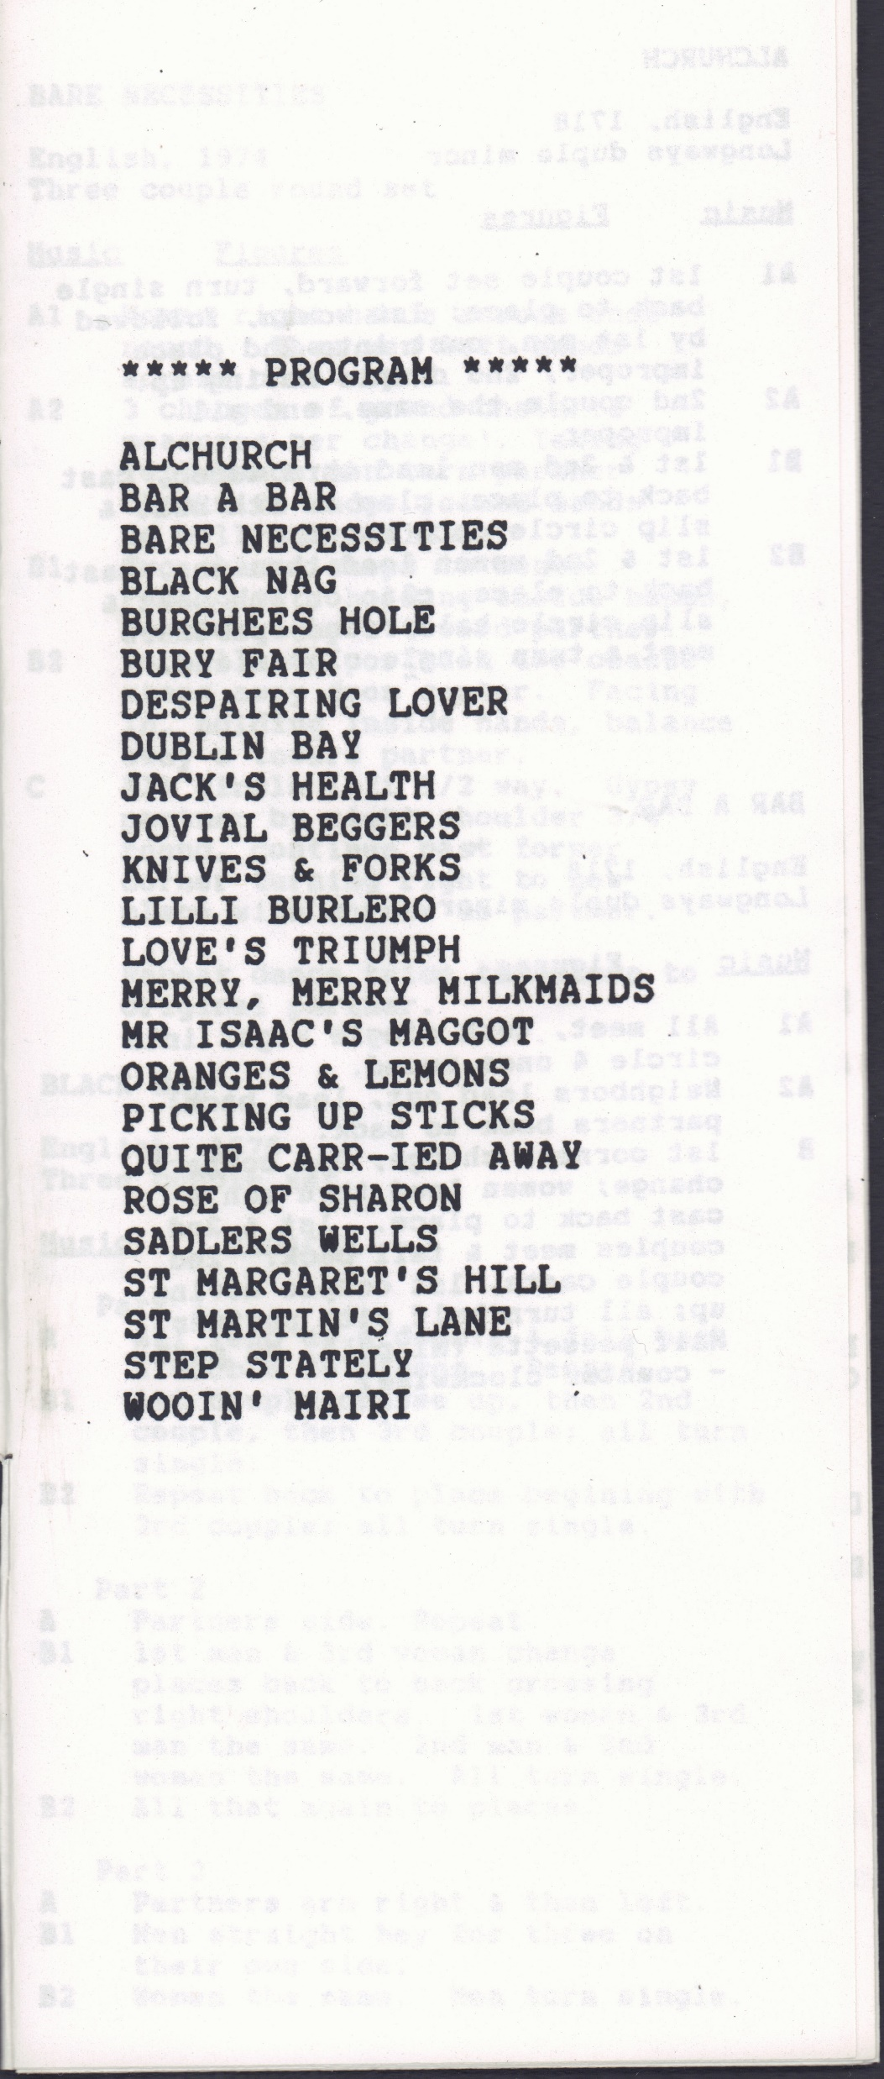
1992

Slide 20
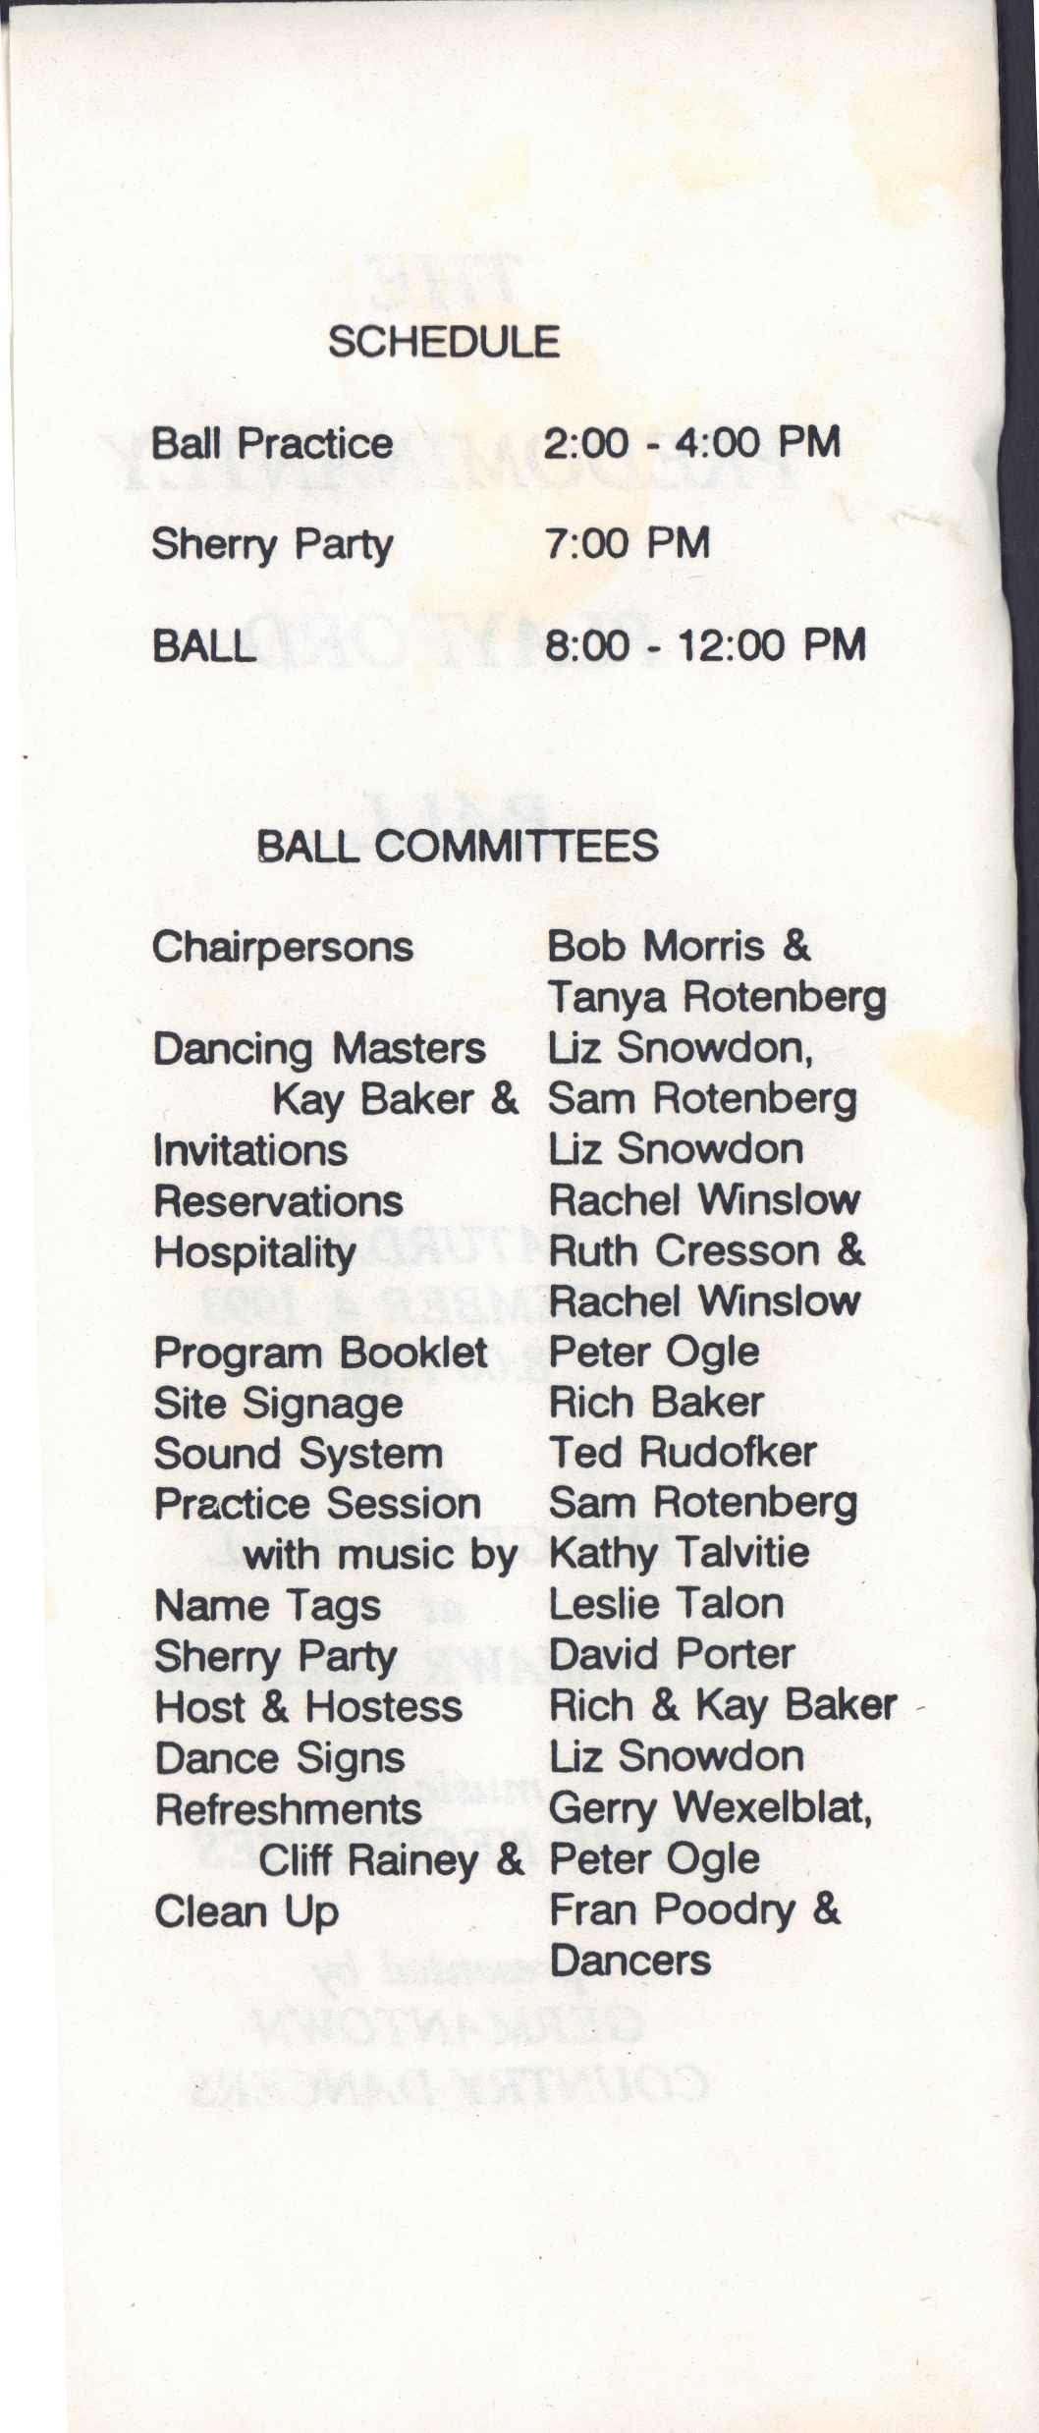
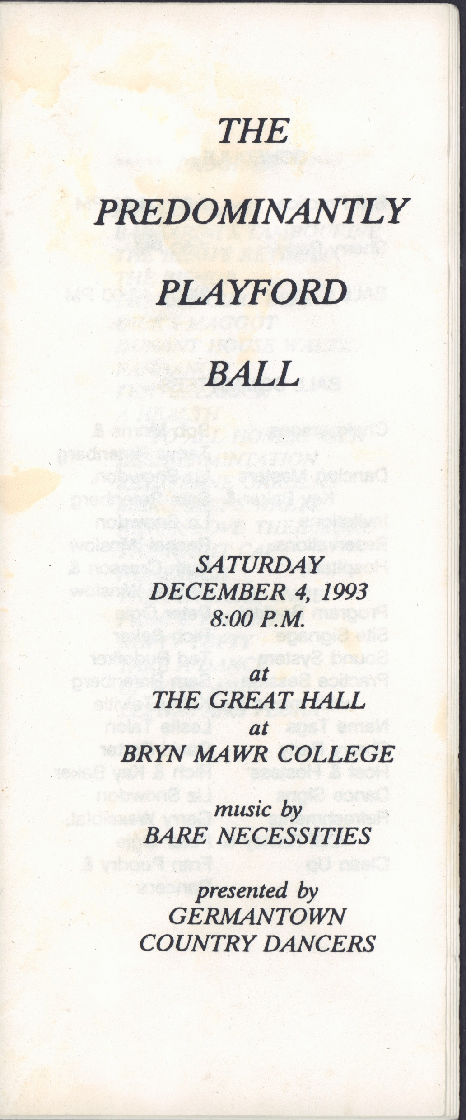
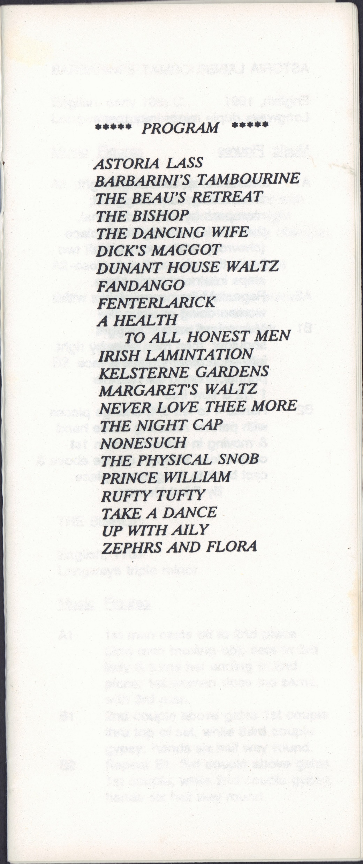
1993

Slide 21



1994

Slide 22



1995

Slide 23



1996

Slide 24



1997

Slide 25



1998

Slide 26



1999

Slide 27



2000

Slide 28



2001

Slide 29


The Program
Apley House
A New Beginning
Bonnie Cuckoo
Nonesuch
Christina
Round About Our Coalfire
Errol on the Green
Severn Bore
Fandango
Splendid Shilling
Fenterlarick
Take A Dance
Jacob Hall’s Jig
Trip to Kilburn
Juice of Barley
Trip to the Manors
King of Poland
Turning By Threes
Minor Spaniard
Volpony
Mr. Isaac’s Maggot
Walpole Cottage
2002
Notes:
2002 program missing

Slide 30



2003

Slide 31



2005

Slide 32



2004

Slide 33



2006

Slide 34
2007

Slide 35
2008

Slide 36



2009

Slide 37



2010

Slide 38
2011

Slide 39



2012

Slide 40



2013

Slide 41




2014

Slide 42



2015

Slide 43
2016

Slide 44


2017

Slide 45



2018

Slide 46



2019

Slide 47

Germantown Country Dancers invite you to
the Ballternative
December 5, 2020
Online for as many as will.
2020

